Slide 1
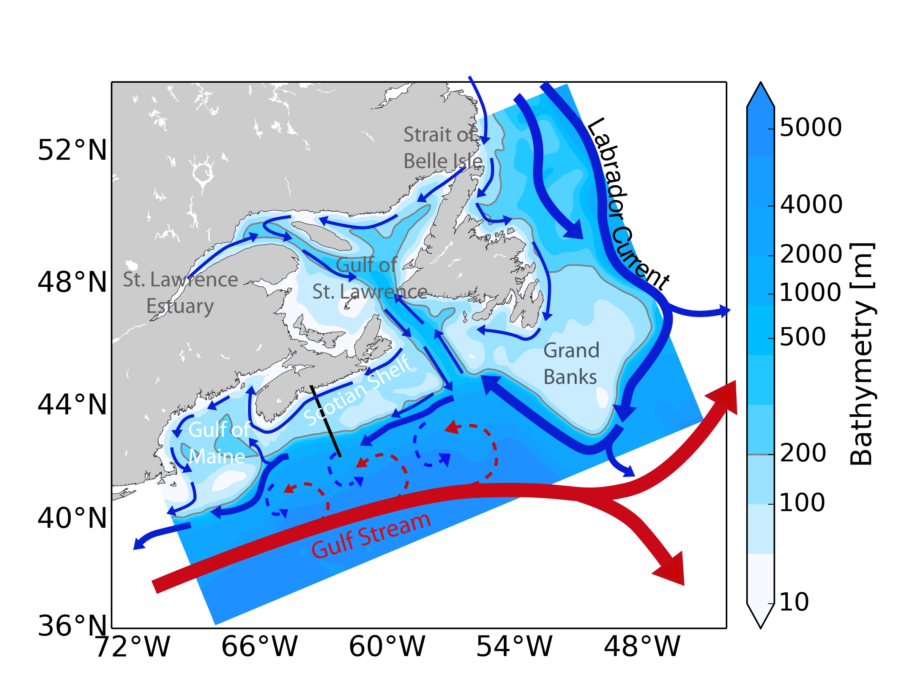
Biogeochemical Trends and
Their Ecosystem Impacts in
Atlantic Canada
Katja Fennel, Krysten Rutherford,
Angela Kuhn, Wenxia Zhang,
Katie Brennan, Laura Bianucci,
Rui Zhang
AGU Fall Meeting, December 15, 2016

Slide 2
Coastal & shelf ecosystems
are vulnerable to ocean warming, de-oxygenation, acidification, eutrophication and overfishing,
have large air-sea fluxes of CO₂, but poorly quantified, and
they are most relevant for human activities.
Northwestern North Atlantic, historically a rich fishing ground, emerged as prominent climate change region with high rate of warming and large reductions in subsurface oxygen (Bopp et al. 2013).
Large changes have already been observed, e.g.
- 1.0 mmol O₂ m⁻³ yr⁻¹ in the Gulf of
St. Lawrence (1932-2003)
- 1.1 mmol O₂ m⁻³ yr⁻¹ on the
Scotian Shelf (1960-2002)
(Gilbert et al. 2010)

Slide 3
Northwestern North Atlantic is at the confluence of two major boundary current systems.
Baseline (1999-2014)
10 km horizontal resolution
30 layers
Physical B.C. from Urrego-Blanco & Sheng (2012)
Biochemical B.C. from observations
3-hourly ECMWF ERA-Interim atmospheric forcing
12 major rivers
Tides
No ice
Regional ROMS implementation for Atlantic Canada (AC; Brennan et al. 2016)
Future projection (2066-2081)
Delta method for atmospheric forcing and biochemical B.C.s
B.C. physics from 1/12º North Atlantic simulation (Brickmann et al.)

Slide 4
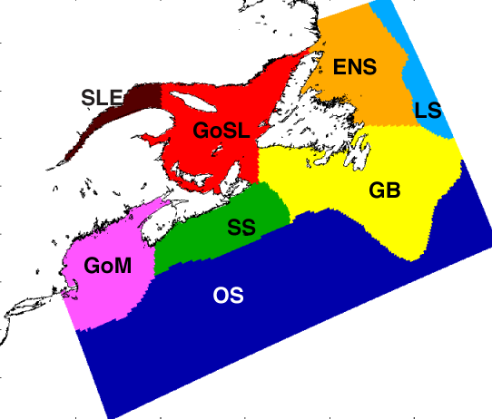
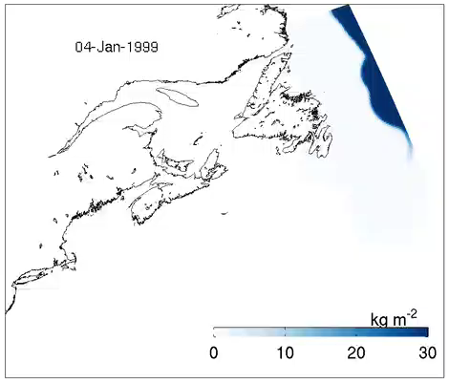
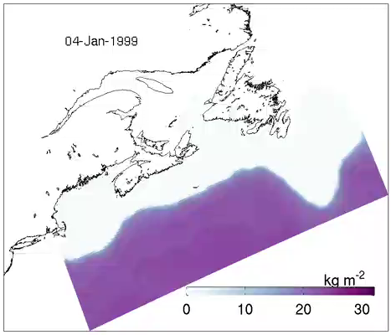
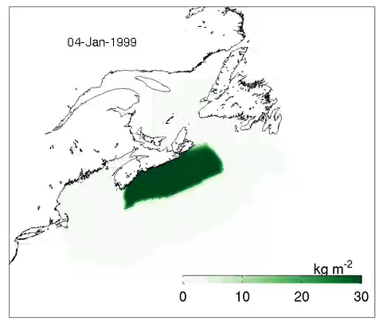
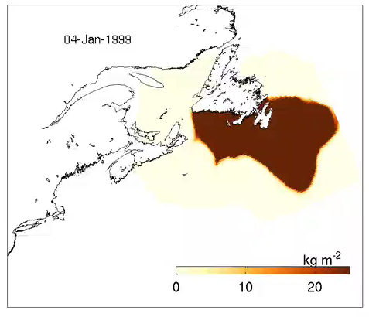
deep OS
LS
SS
GB
Rutherford, Fennel & Zhang (in prep.)

Slide 5
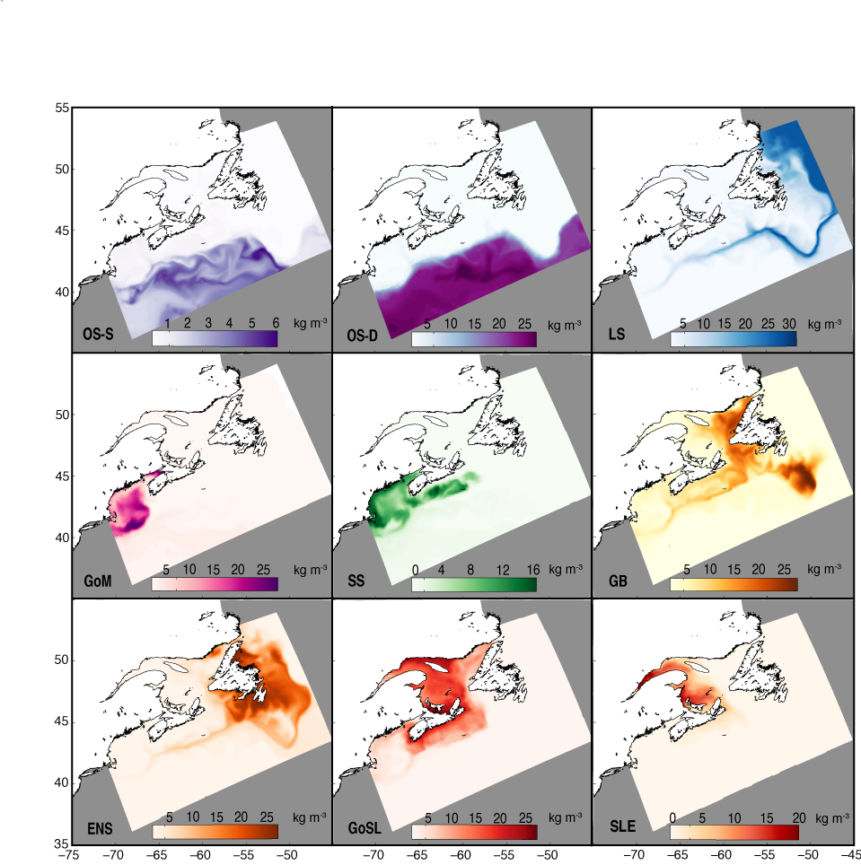
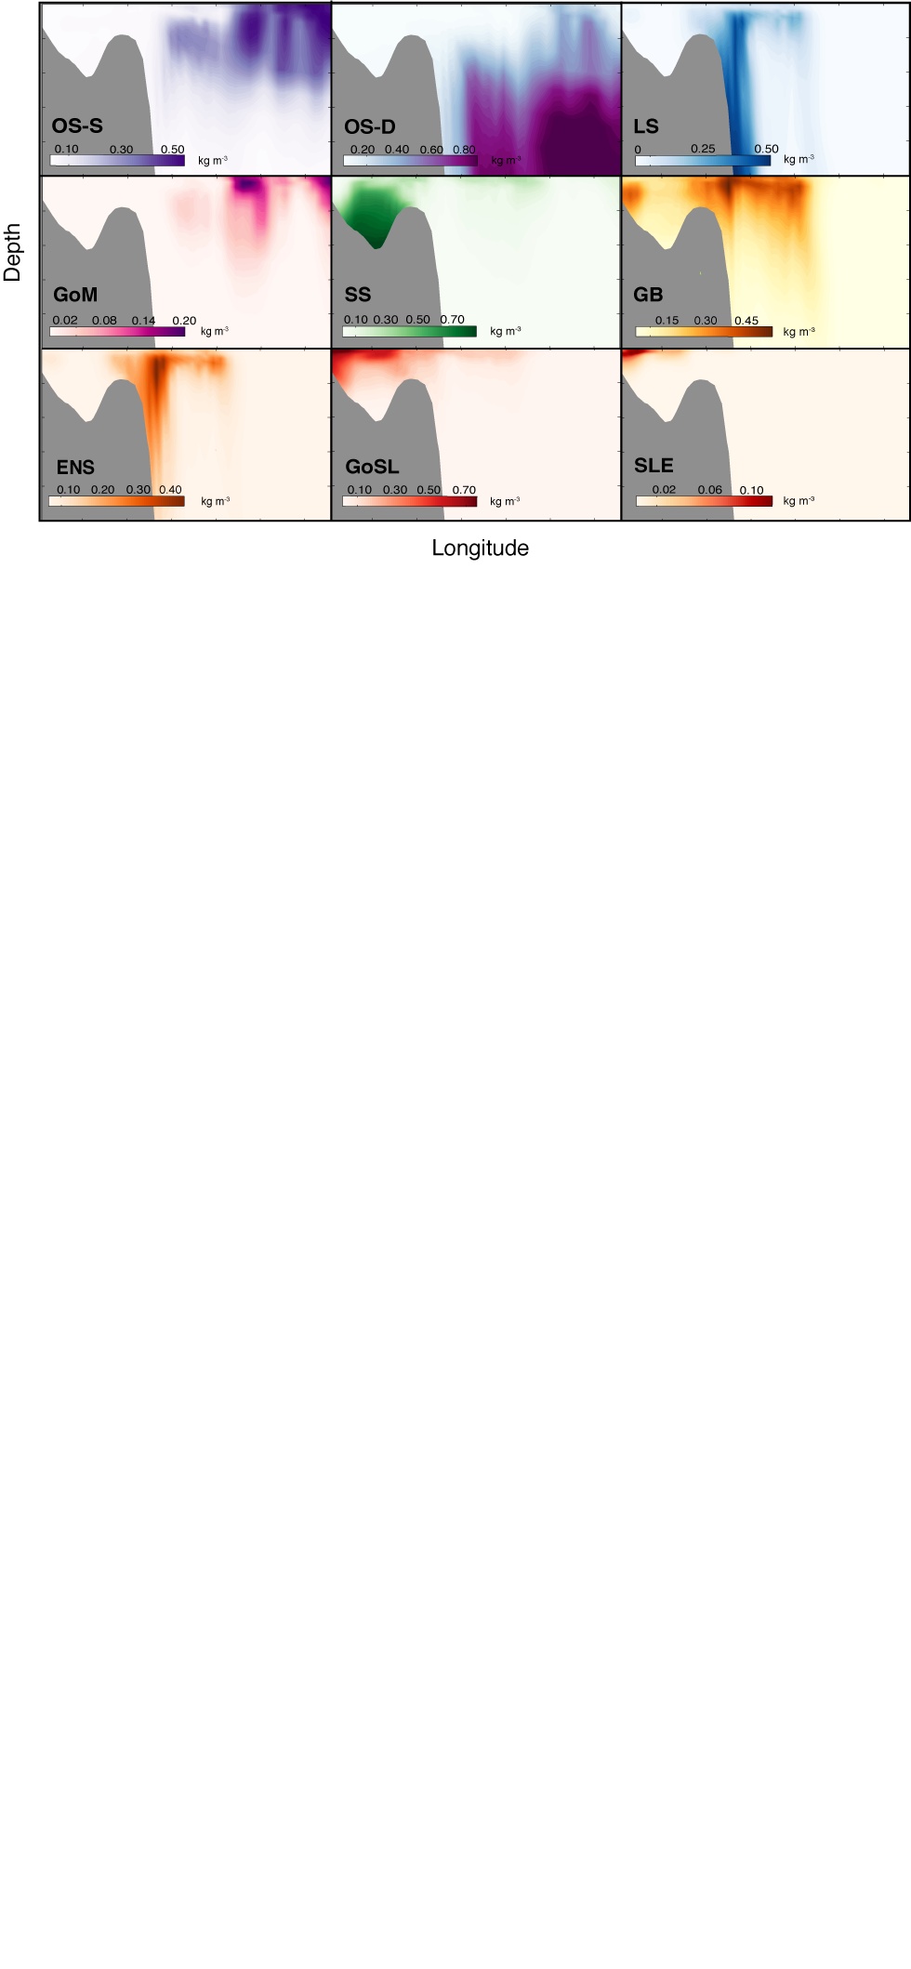
AC model flushing times
GB 424 days
GoSL 554 days
SS 210 days
GoM 512 days
Flushing time estimates from global model (Bourgeois et al. 2016)
region 10 (SS, GoM, MAB, SAB) 12 days
region 11 (GoSL, GB, LS) 36 days
Rutherford, Fennel & Zhang (in prep.)

Slide 6
CMIP5 models
World Ocean Atlas

Slide 7
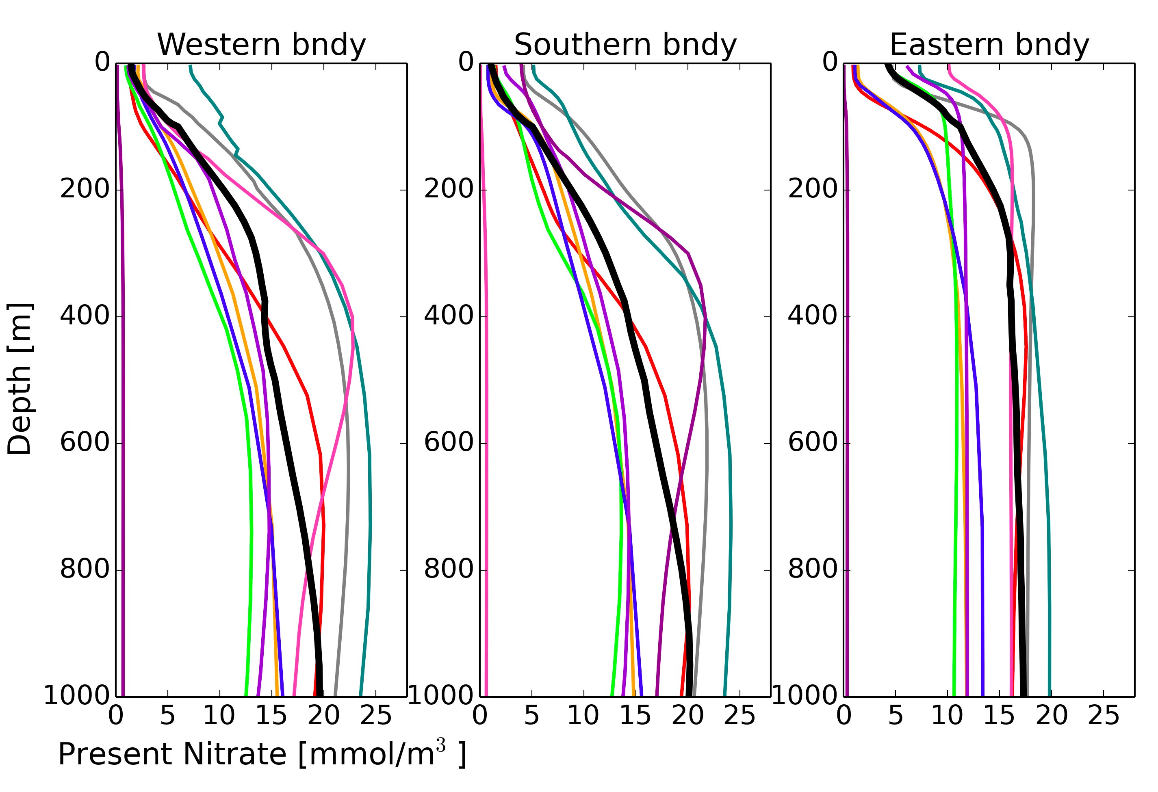
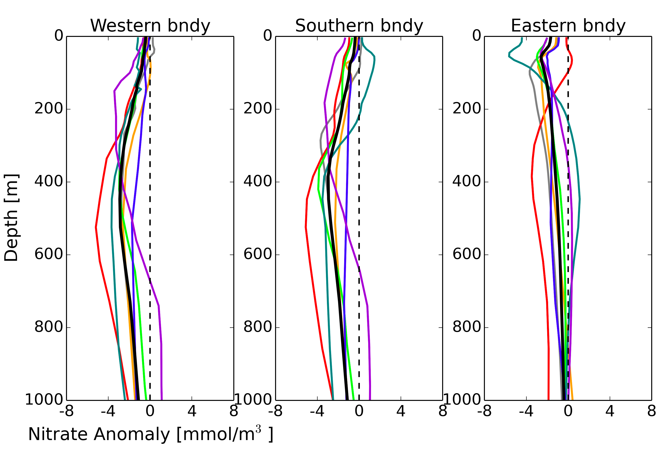
W bndy
S bndy
E bndy
0
200
400
600
800
1000
0
5
10
15
20
25
Present nitrate (mmol/m⁻³)
0
200
400
600
800
1000
-8
4
0
4
8
Anomaly Future - Present (mmol/m⁻³)
Zhang, Fennel & Brickman (in prep.)

Slide 8
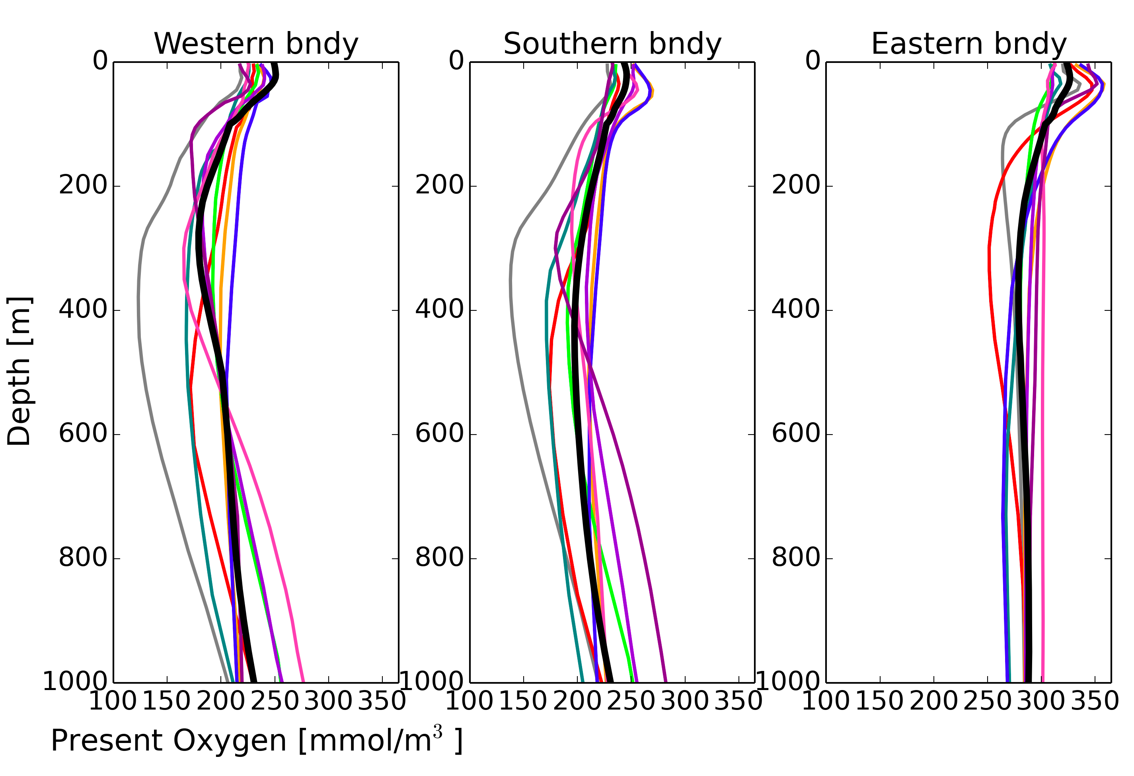
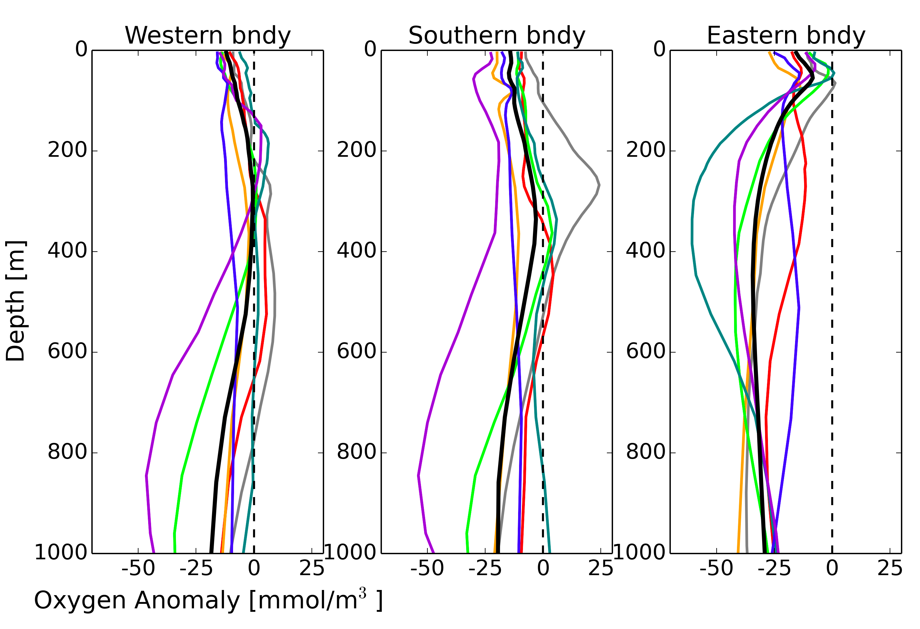
W bndy
S bndy
E bndy
0
200
400
600
800
1000
100
200
300
Present oxygen (mmol/m⁻³)
0
200
400
600
800
1000
-50
-25
0
25
Anomaly Future - Present (mmol/m⁻³)
Zhang, Fennel & Brickman (in prep.)

Slide 9
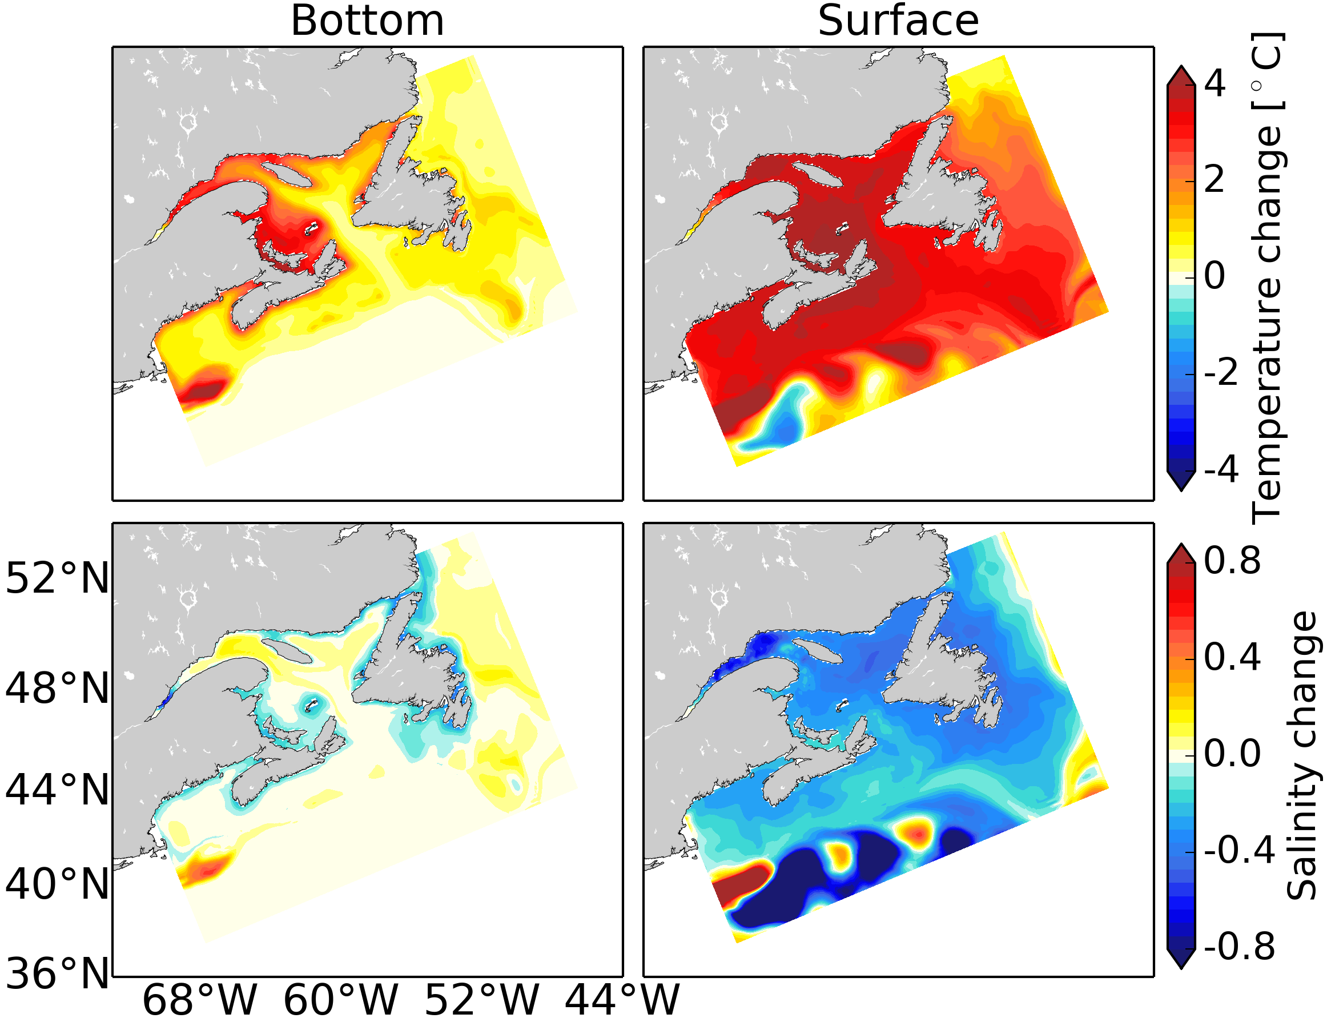
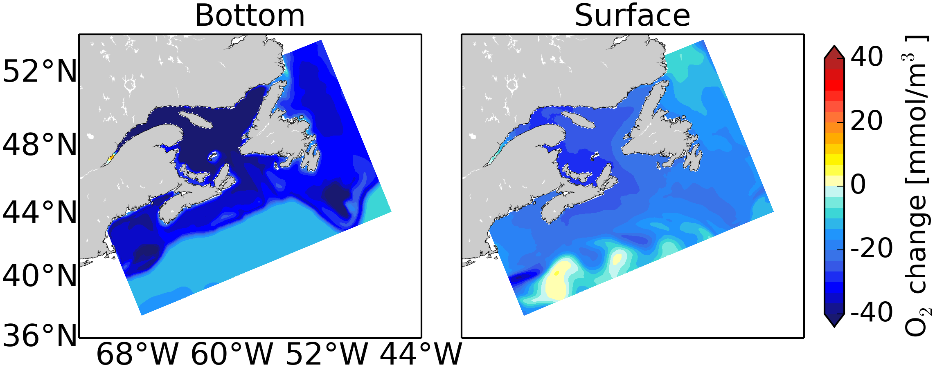
Temperature
Future – Present (ºC)
bottom
surface
Salinity
Future – Present
bottom
surface
Oxygen
Future – Present
(mmol/m⁻³)
Zhang, Fennel & Brickman (in prep.)
bottom
surface

Slide 10
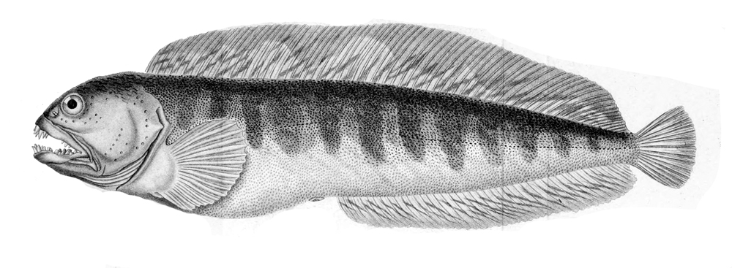

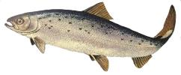
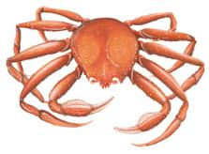
How will marine species in the Atlantic Canada region respond to these changes?
species-specific thresholds + regional ocean model + climate change forcing
  Identified key marine fish and macro-invertebrate species in the Gulf of St. Lawrence and Scotian Shelf region (53 species + life stages, i.e. egg, larvae, juvenile, adult)
  Reviewed experimental and observational studies regarding salinity, temperature, oxygen, pH
Criteria for species inclusion:
Support a commercial fishery.
Threatened or at risk status.
Bycatch, baitfish, invasive, vagrant, important for ecosystem energy transfer, or predator or prey of the above species.
Brennan, Blanchard & Fennel, Plos ONE (2016)

Slide 11
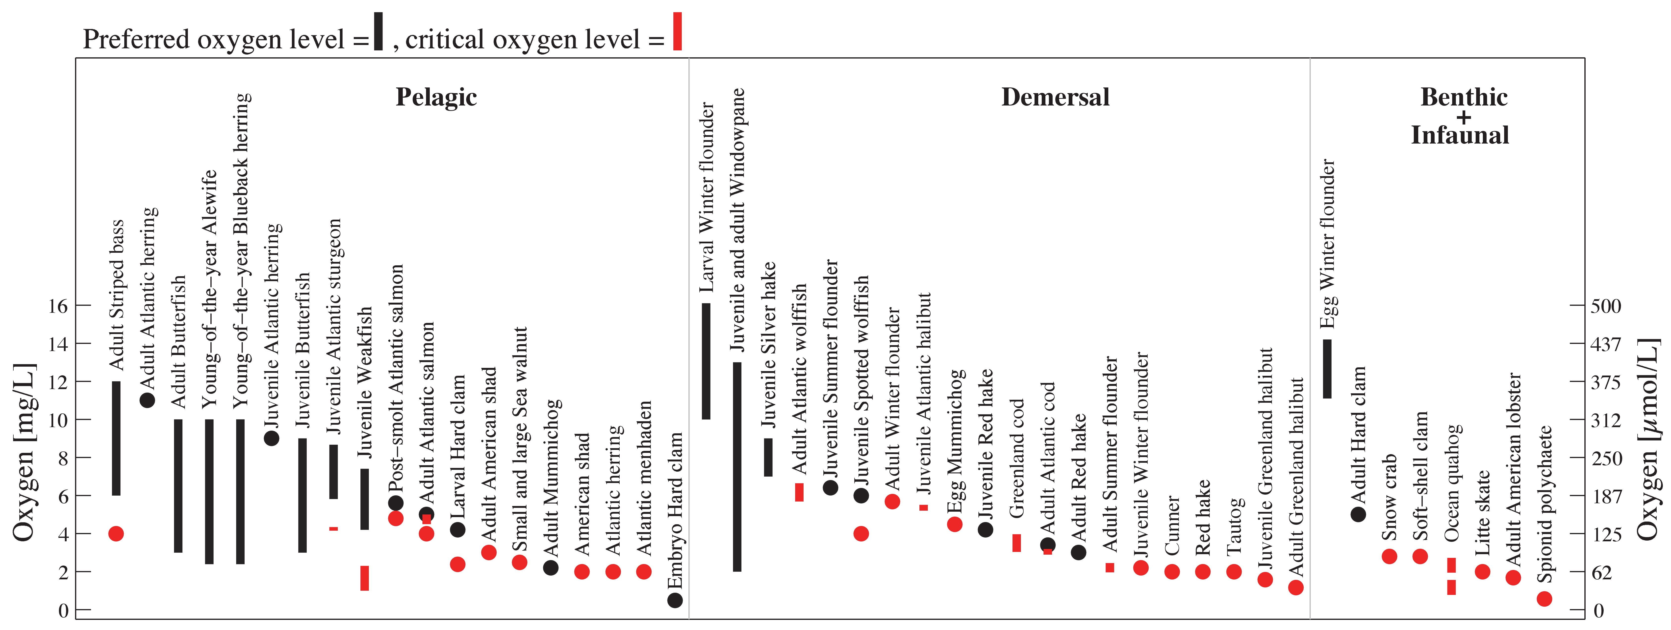
No adverse effects; “suitable” & “optimal” oxygen.
Level at which oxygen consumption becomes dependent on oxygen concentration (the point at which metabolism slows)
Preferred oxygen level =
Critical oxygen level =
Greenland Halibut
Oxygen [μM]
Post-smolt Atlantic Salmon
Atlantic Wolffish
Snow Crab
Brennan, Blanchard & Fennel, Plos ONE (2016)
Notes:
Thresholds compiled by Brennan et al. Oxygen on the Y axis, and different species are shown in the X axis, separated in 3 groups according to their vertical habitat: pelagic, demersal, benthic & infaunal.
The black symbols show the preferred oxygen levels reported in the literature for the different species (bars when ranges were reported or circles if single values were reported), while the red show the critical oxygen levels at which each species are negatively affected by oxygen concentrations.
Animals with the highest critical levels will be the first ones affected by decreasing oxygen levels. In this case, post-smolt Atlantic salmon, the Atlantic wolffish and snow crab, in each of the habitats.
Animals with low thresholds, such as the Adult Greenland Halibut, will be more resilient to declining oxygen.
Atlantic wolffish has the overall highest critical threshold of 6.64 mg/L, equivalent to 207 uM or 70% sat
Atlantic wolffish is listed as a species of special concern under the Species at Risk Act.
---Brennan et al
Pelagic organisms occupy the middle or surface ocean waters uninfluenced by the shore or bottom; demersal species live on or near the seabed; benthic creatures live on the seabed; and infauna live within bottom substrate.
critical oxygen level is not consistently defined across the literature, and in many cases is undefined. Here we assume critical oxygen to represent the level at which oxygen consumption becomes dependent on oxygen concentration, or in other words, as the point at which metabolism slows

Slide 12
Brennan, Blanchard & Fennel, Plos ONE (2016)

Slide 13
Observed distribution of Atlantic Wolffish on Scotian Shelf
1970 - 1977
Quantile Breaks
1994 – 2006
none observed
1-20th percentile
21-40th percentile
41-60th percentile
61-80th percentile
81-100th percentile
Horsman and Shackell (2009)
Notes:
A bit of background of Atlantic Wolffish. This is a species listed as special concern under the Species at Risk Act (SARA) and COSEWIC. The figures here compare the observed distributions on the Scotian Shelf in the 70’ against the late 90’s early 2000’s. The less amount of red that we see in the most recent times indicate the decrease in the abundance of wolffish.
----
Atlantic Wolffish (Anarhichas lupus): •
Species of special concern under the Species at Risk Act (SARA) •
Identified as depleted on the Scotian Shelf (Horsman and Shackell, 2009; fig. 7) •
Oxygen levels below 60 – 70% saturation leads to physiological problems (Jouaquim and Gamperl, 2004). •
Sensitive to temperature, especially during their planktonic larval and early juvenile stages (February to April). Critical temperature threshold for growth and survival: 9 – 11oC (Natural Resources Canada, 2007).

Slide 14
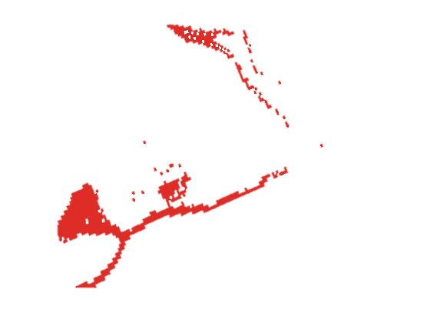
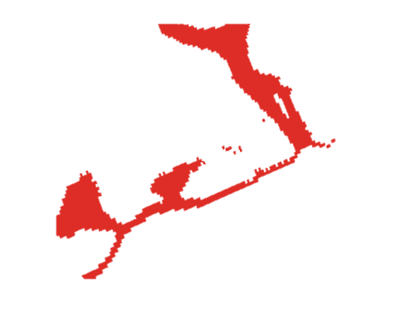
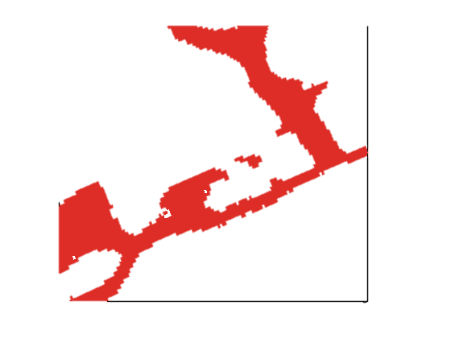
Observed distribution of Atlantic Wolffish on Scotian Shelf
1970 - 1977
Quantile Breaks
1994 – 2006
none observed
1-20th percentile
21-40th percentile
41-60th percentile
61-80th percentile
81-100th percentile
Horsman and Shackell (2009)
Bianucci et al. (2016)
projection
Notes:
The overlapped red areas are the climatological conditions for bottom oxygen concentrations Pre-1980 (left – data for 1930 to 1980) and Post-1980 (right, data for 1980 to 2010). Showing bottom O2 because Atlantic Wolffish is a demersal fish that lives near the seafloor.

Slide 15
Summary
The northwestern North Atlantic is a dynamically complex region; challenging to global models – regional approaches are needed.
Residence time of shelf water is long. Exchange across the shelf edge is inhibited.
In future projections oxygen concentrations in bottom waters drop dramatically (by up to 60 mmol m⁻³ by 2070ies) inside the domain due to internal dynamics (signal is not propagated from lateral boundaries).
Ongoing and projected future changes are squeezing suitable habitat for endangered and commercially important species.

