Slide 1
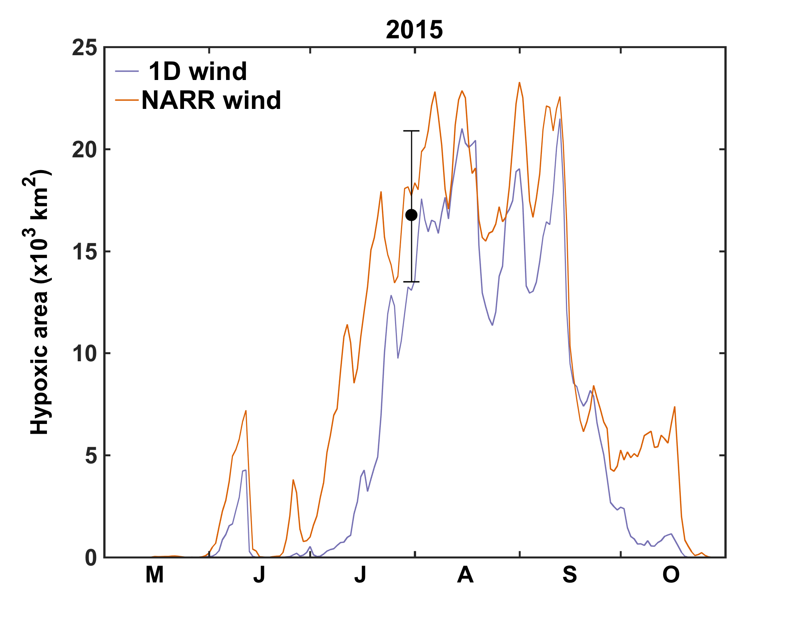
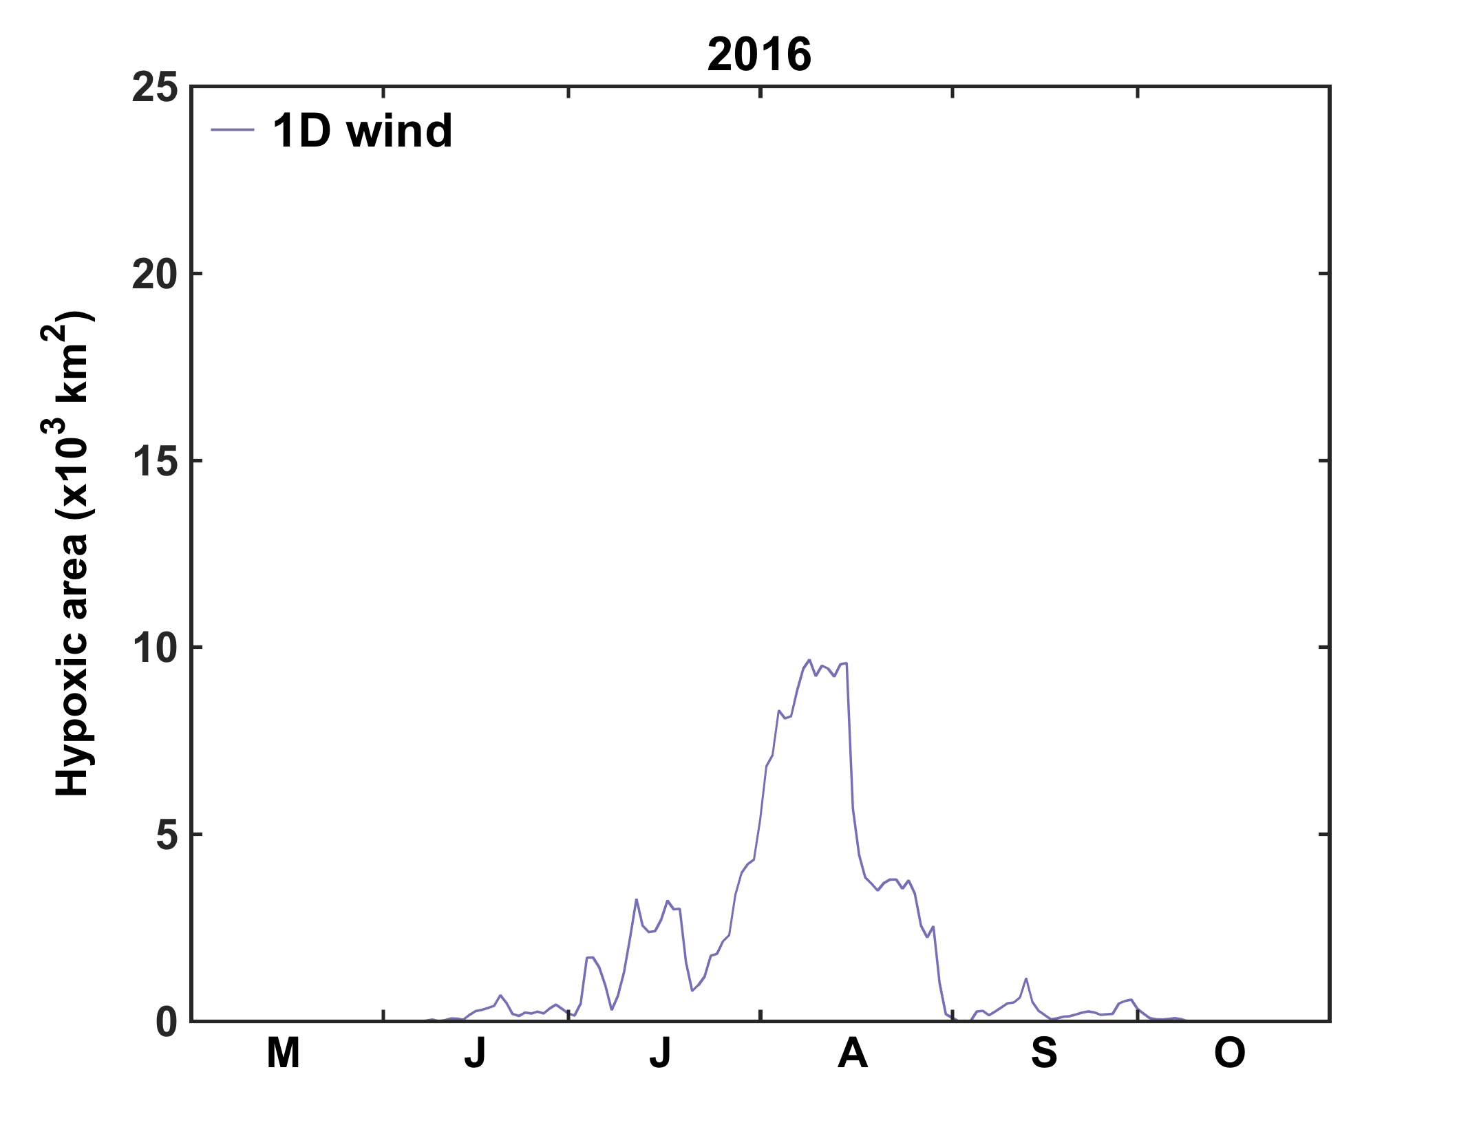
Hypoxic area time series for 2015 and 2016 from ROMS (using two different wind products: NARR: orange line, 1D station from global NCEP: purple line)
Note: We usually use NARR winds (a 2D high-resolution product), but this is presently only available up to June 2016. Because we need wind forcing for the 2016 hindcast, we used an inferior wind data set (1 location from a coarse resolution global NCEP product).
In 2015, both simulation come close to observed extent, but there are big differences in early July. [Our NARR simulation for 2016 is still running – we can provide this tomorrow]
Why is hypoxic area so much smaller in 2016?

Slide 2
A screenshot from the 2015 animation showing extensive freshwater over the shelf in late July.
salinity
DO at the
bottom &
on two
transects

Slide 3
Screenshot from 2016 movie at the same time shows less freshwater capping and less hypoxia

Slide 4
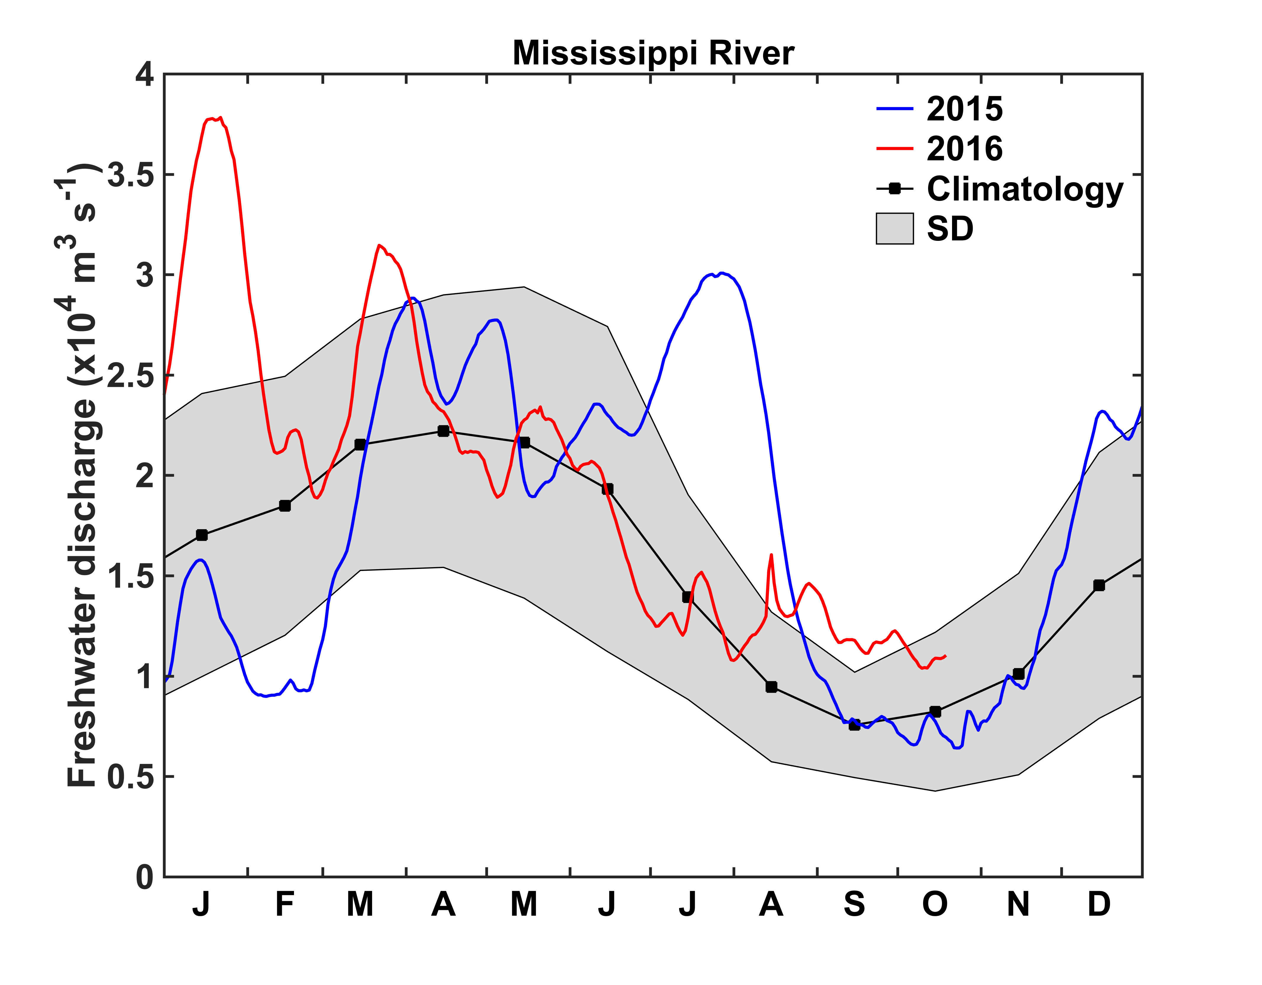
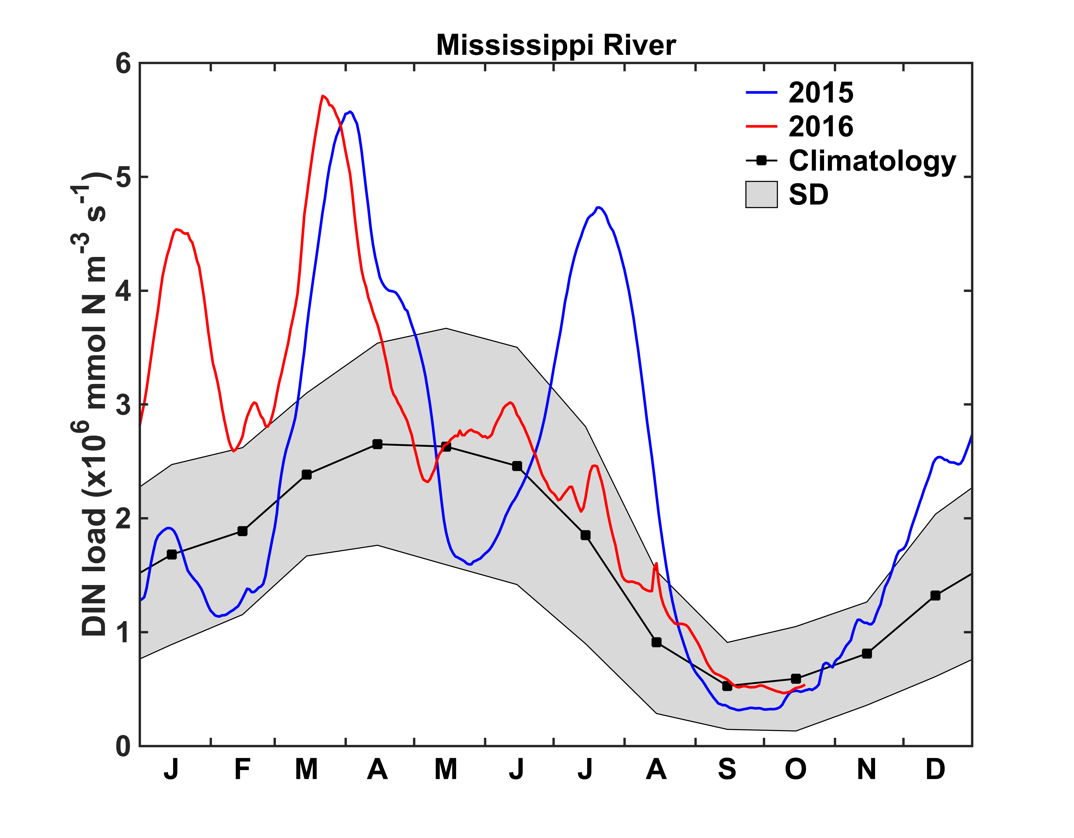
Note the large freshwater discharge and DIN load in summer 2015.
In 2016 both are closer to average in the summer.
[We are still looking into the role of the wind forcing, but summer freshwater input is definitely a big factor in explaining differences between 2015 and 2016.]

Slide 5
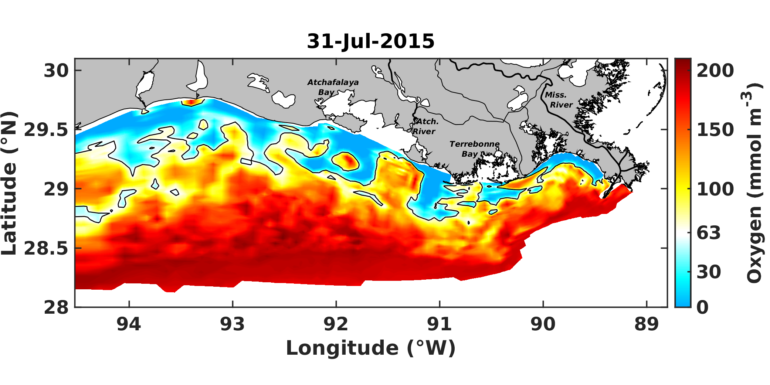
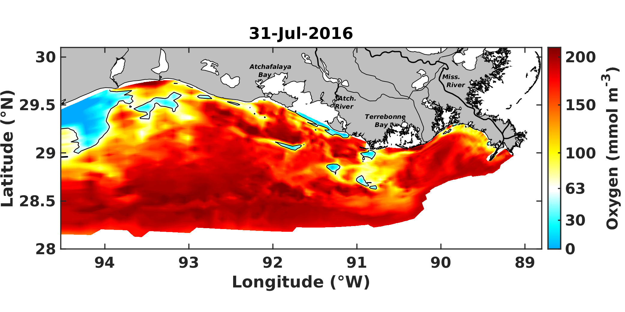
Bottom DO at time of hypoxia cruise (both for 1D wind)

Slide 6
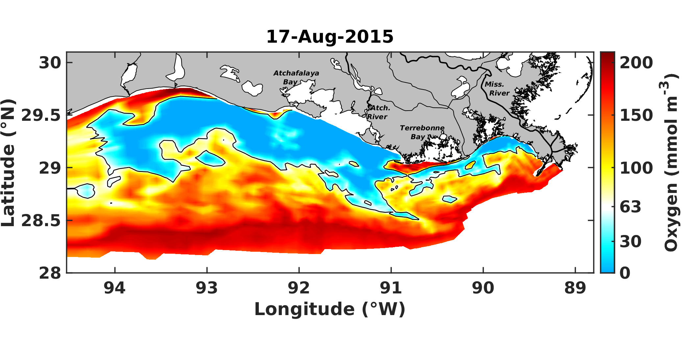
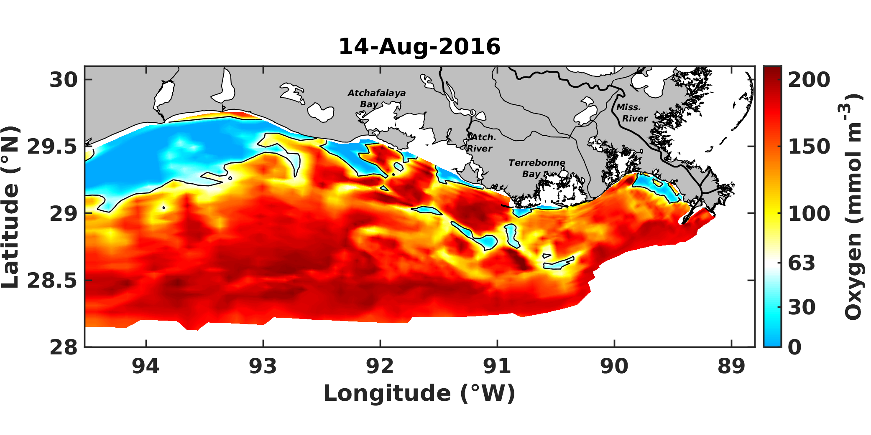
Bottom DO at time of maximum hypoxic extent (both for 1D wind)

Slide 7
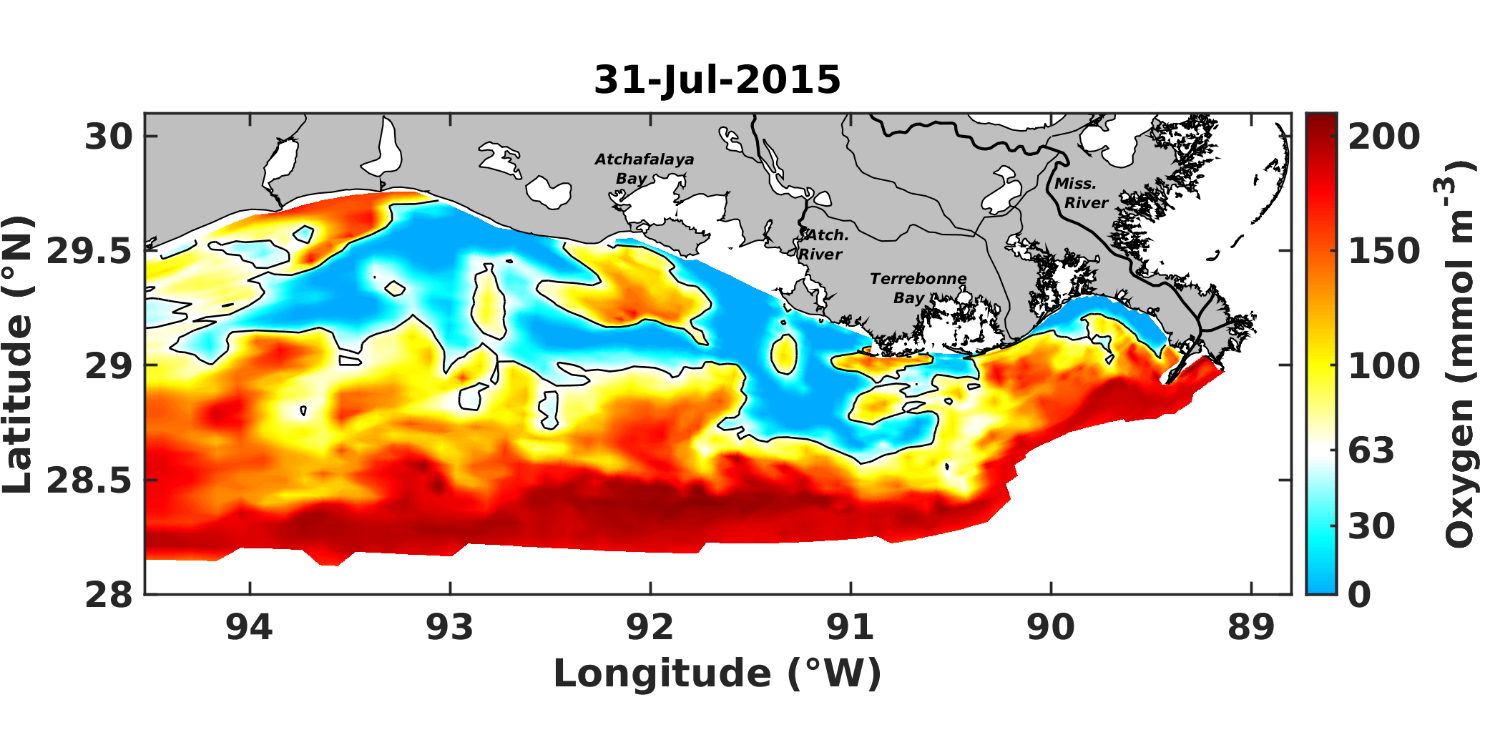
NARR wind
1D wind
Bottom DO at time of hypoxic cruise for NARR wind versus 1D wind
Spatial distribution for NARR wind matches the observed distribution shown on Gulfhypoxia.net

Slide 8
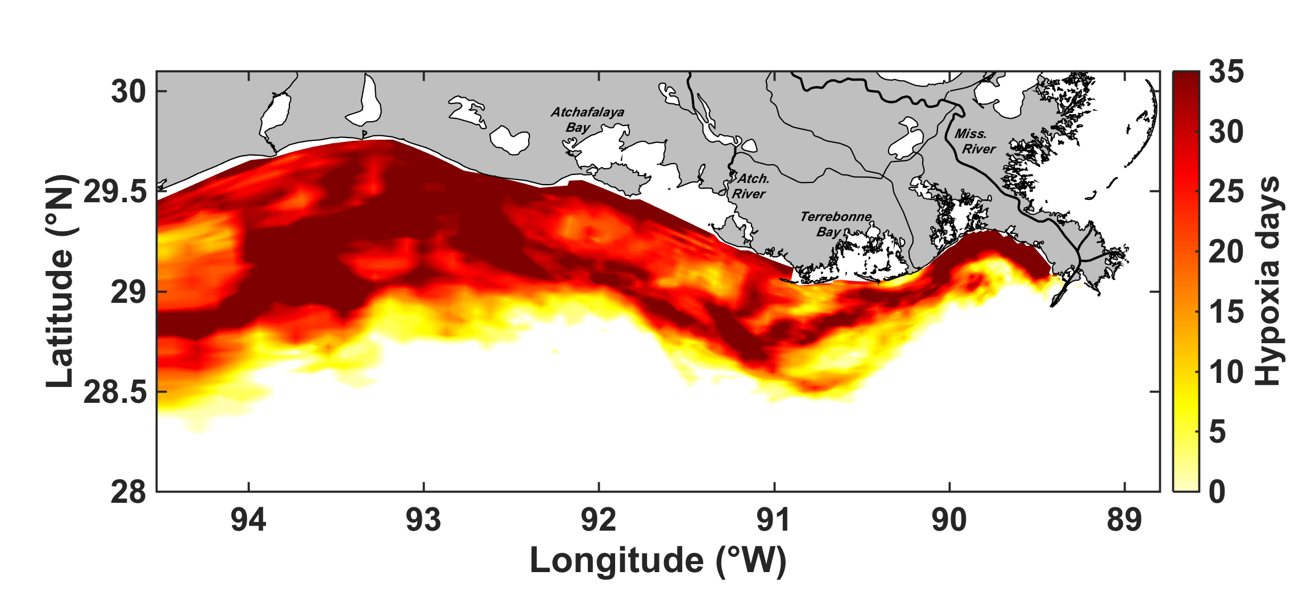
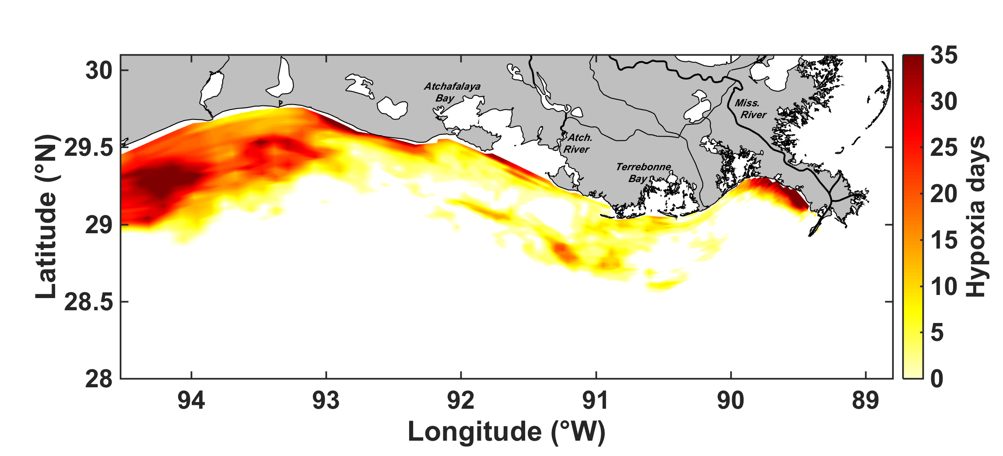
2015 (1D wind)
2016 (1D wind)
Cumulative exposure to hypoxia (number of days hypoxic conditions occurred)

