Slide 1
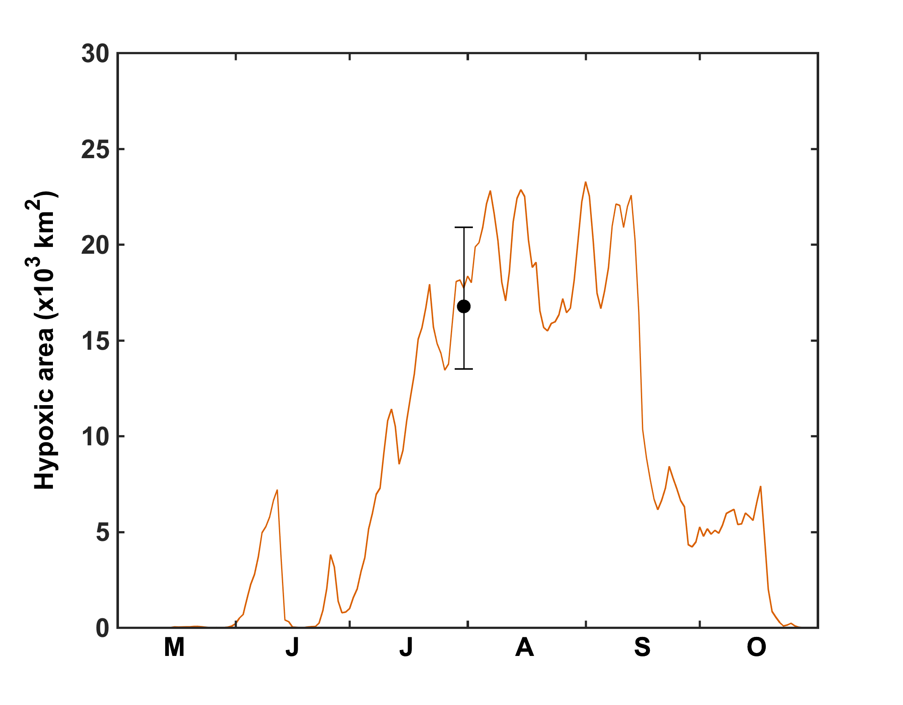
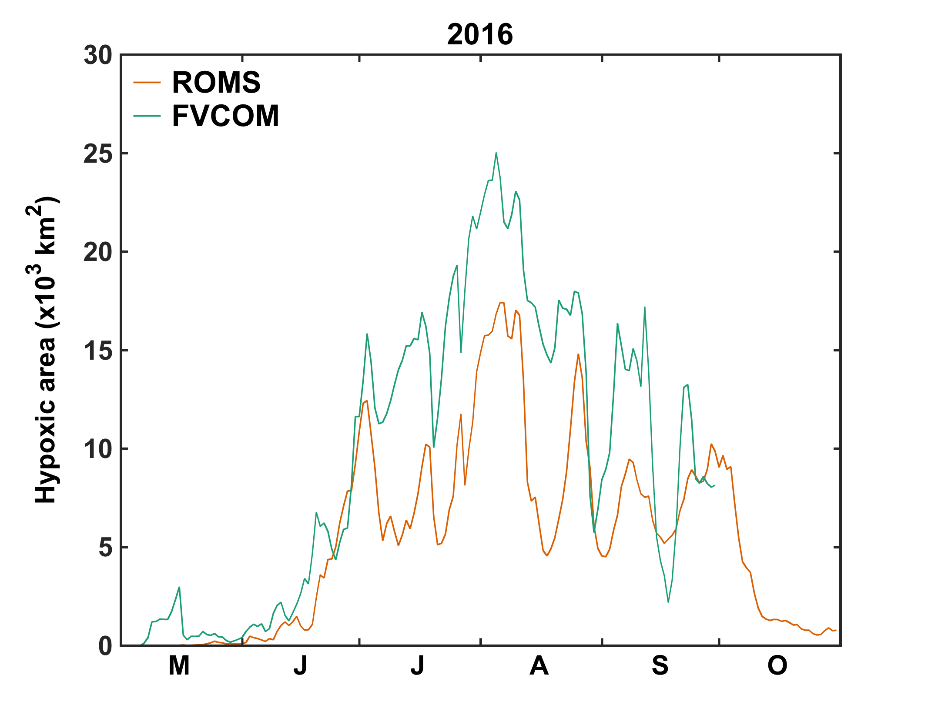
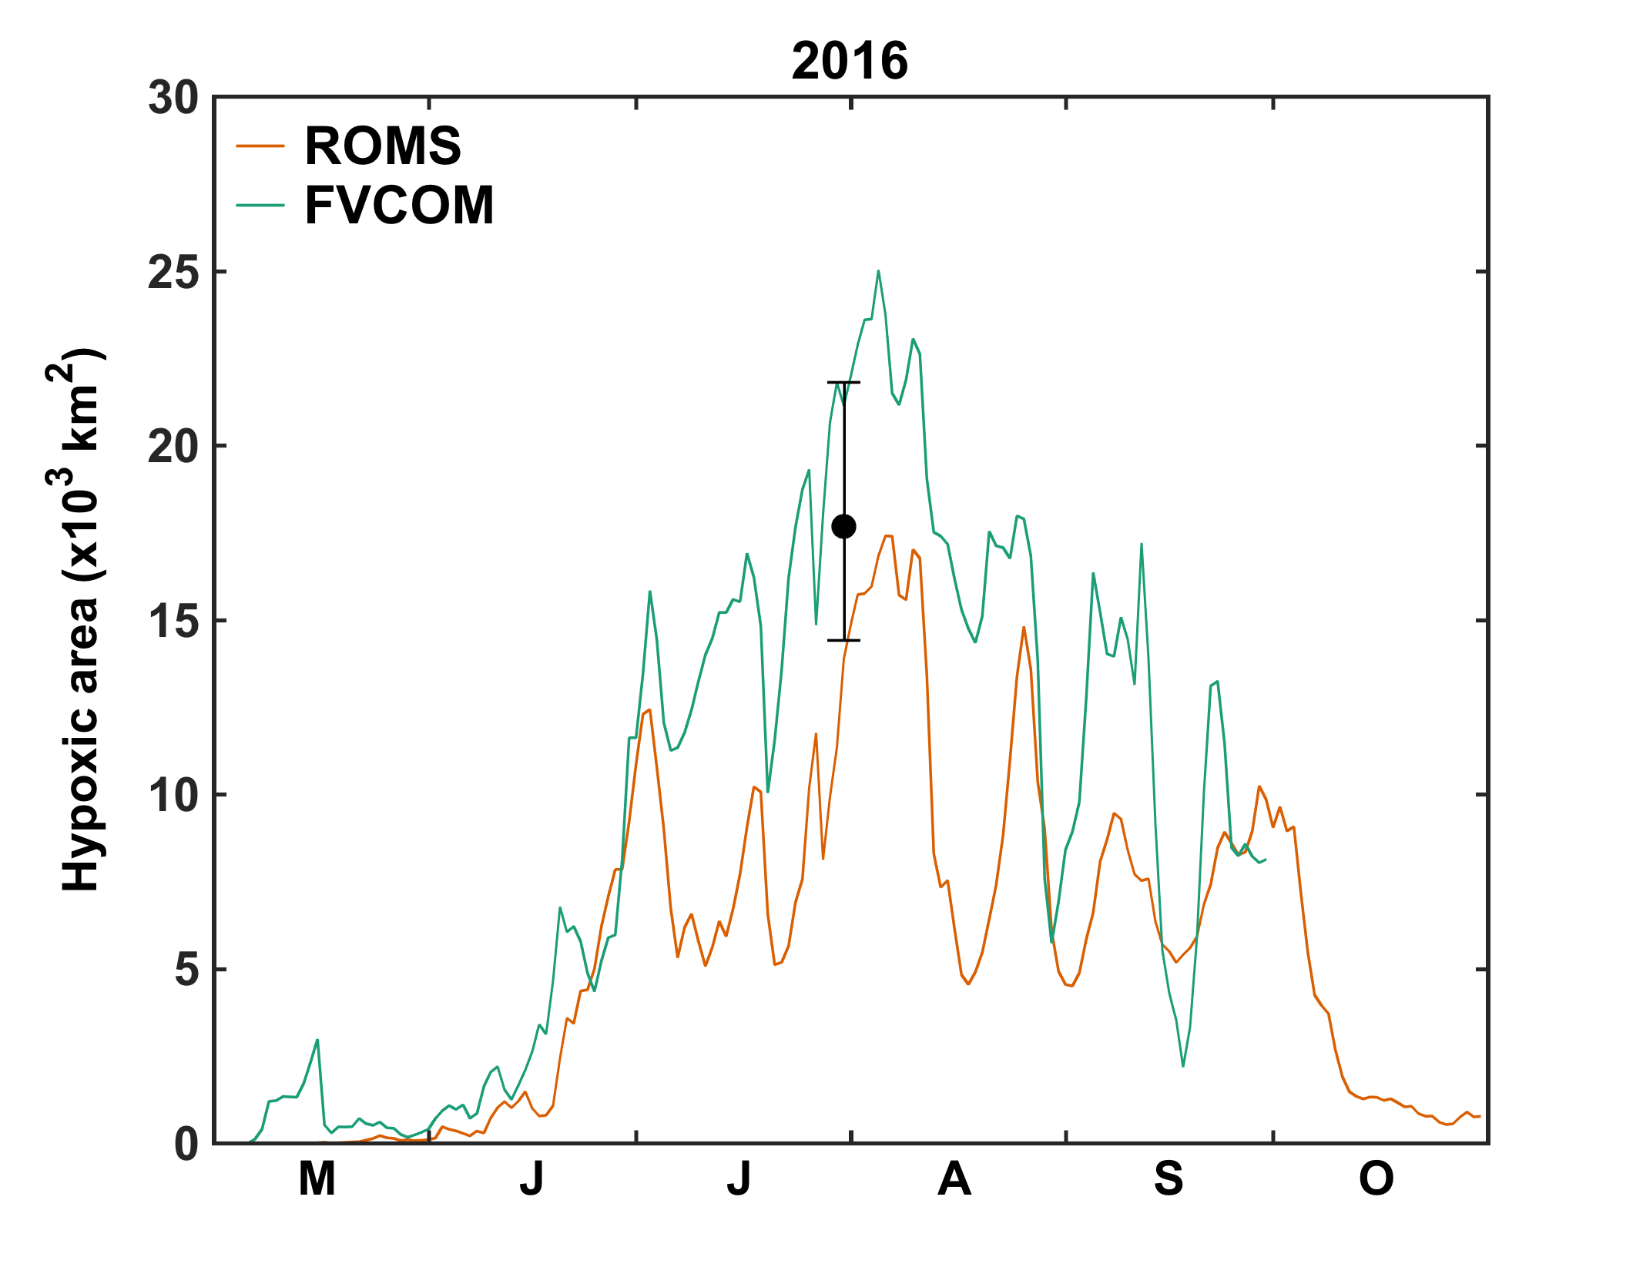
Time series of hypoxic area for 2015 and 2016
2015
Dot is 2015 observed area (from gulfhypoxia.net) with typical uncertainty (from Obenour et al. 2013)
Dot is 2016 forecast (from gulfhypoxia.net) with typical uncertainty (from Obenour et al. 2013)

Slide 2
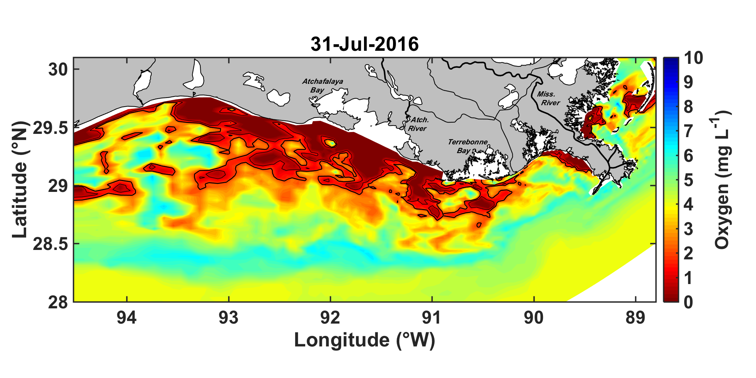
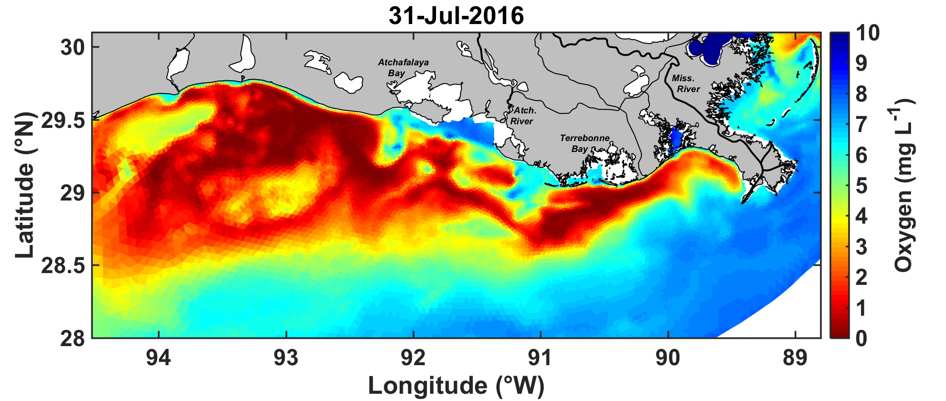
Distribution of hypoxic area 2016 at the time the hypoxia monitoring cruise would have occurred – horizontal view
ROMS (hypoxic area: 13,900 km²)
FVCOM (hypoxic area: 21,100 km²)

Slide 3
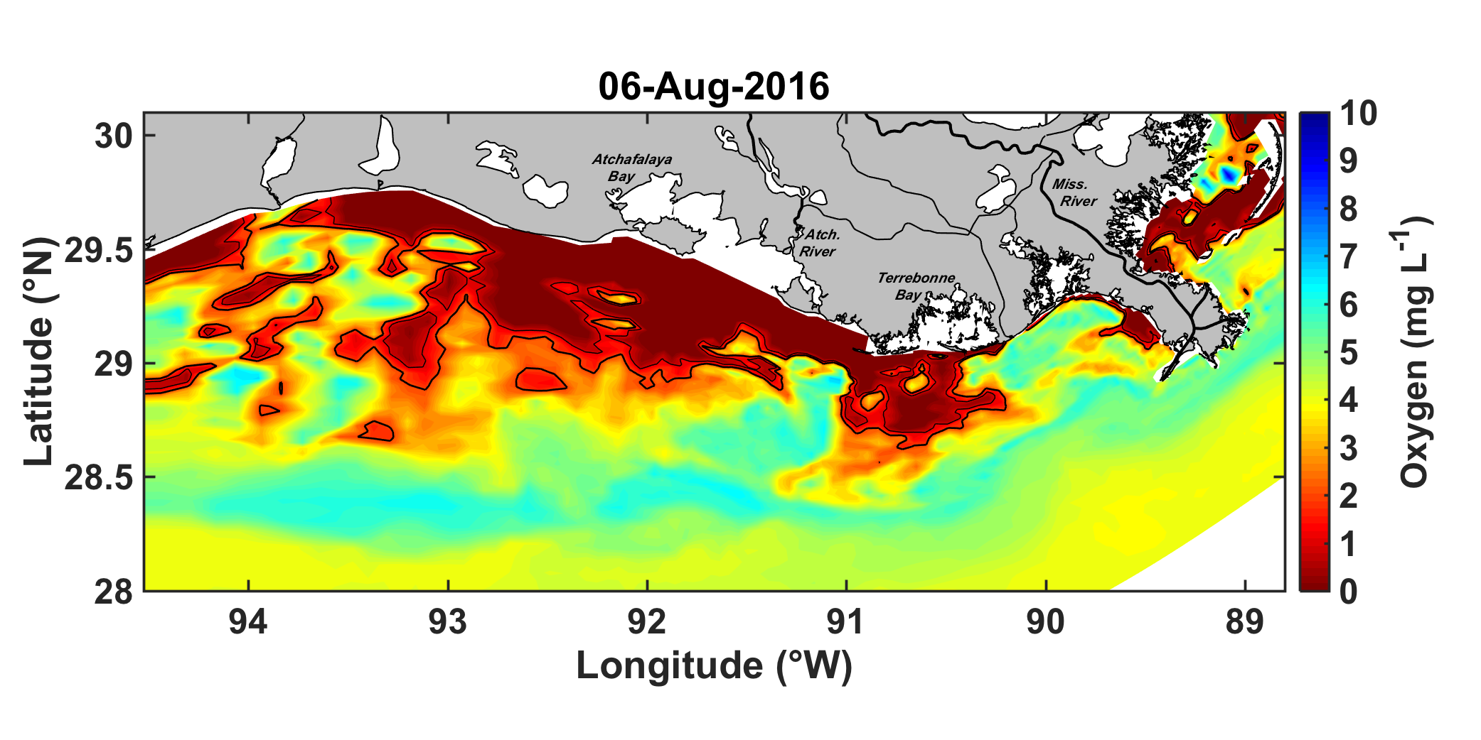
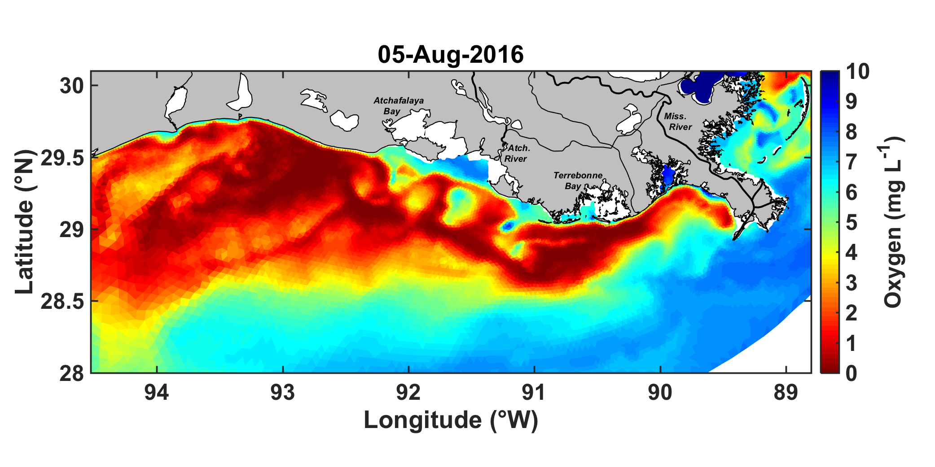
Distribution of hypoxic area 2016 when hypoxic area was at its annual maximum – horizontal view
ROMS (max hypoxic area: 17,400 km²)
FVCOM (max hypoxic area: 25,100 km²)

Slide 4
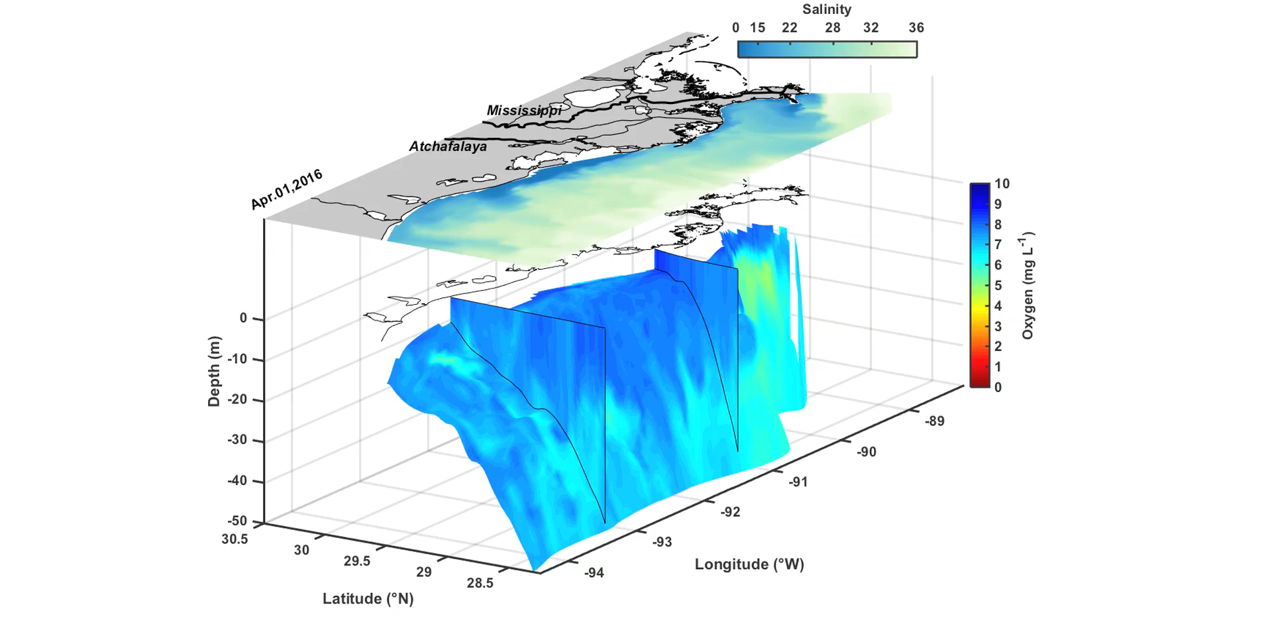
Distribution of hypoxic area 2016 from ROMS – 3D animation
Same animation is also available for 2015
Both can be found here:
http://memg.ocean.dal.ca/fennelk/wip/COMT_2016_hindcast/movies/

Slide 5
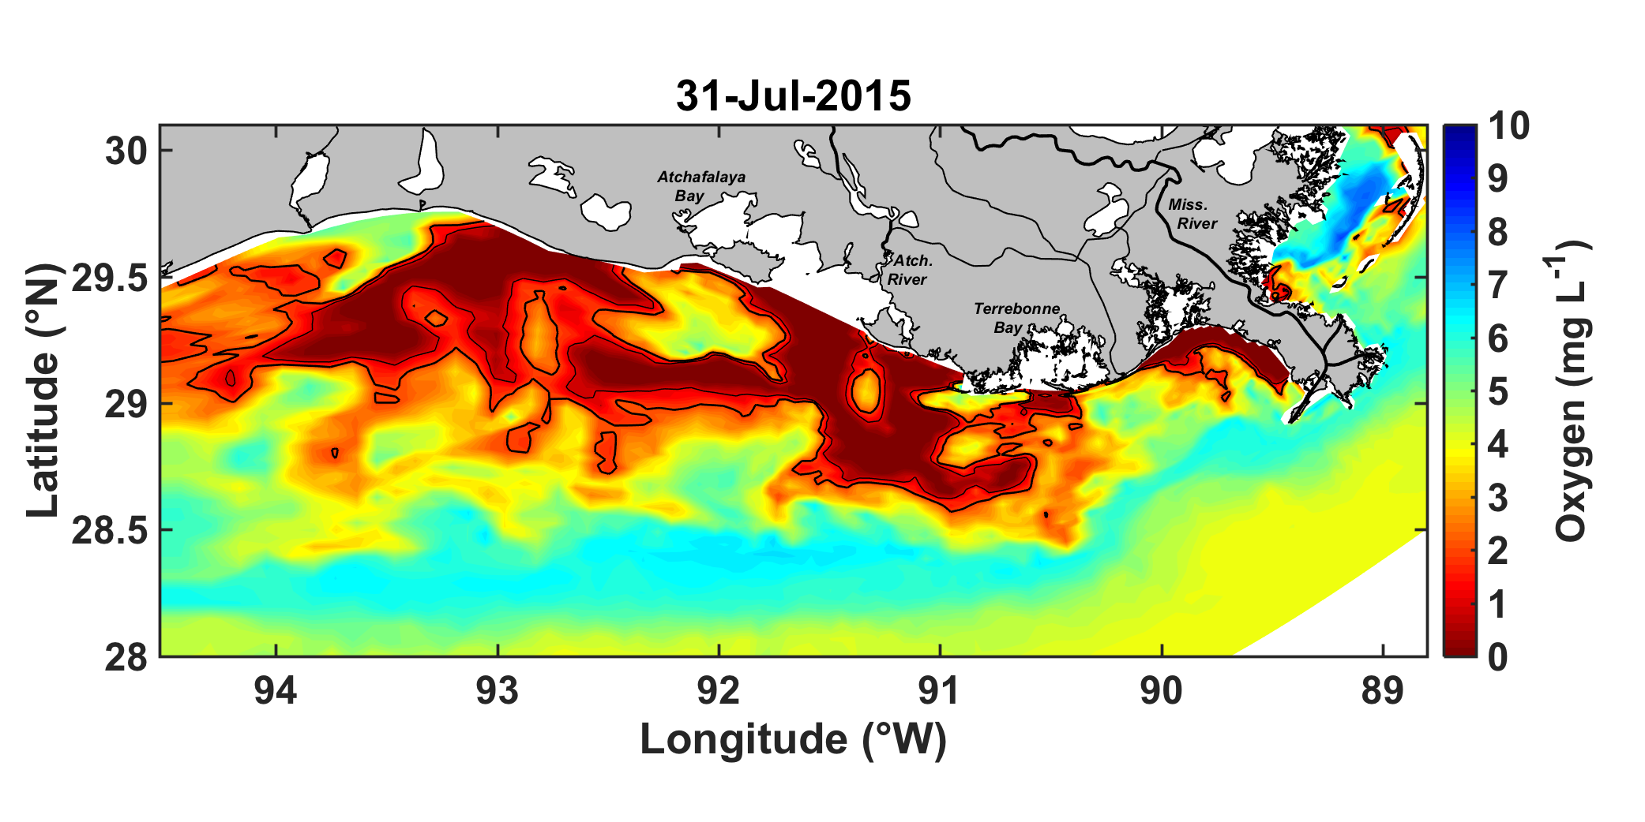
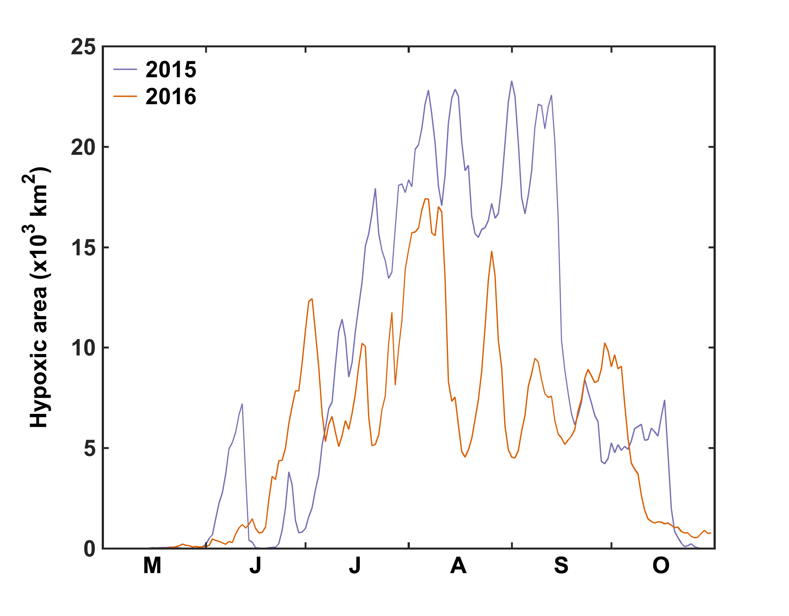
Distribution of hypoxic area in 2015 and 2016 at the time of the hypoxia monitoring cruise (both from ROMS) – horizontal view
Area is slightly smaller in 2016 than 2015:

Slide 6
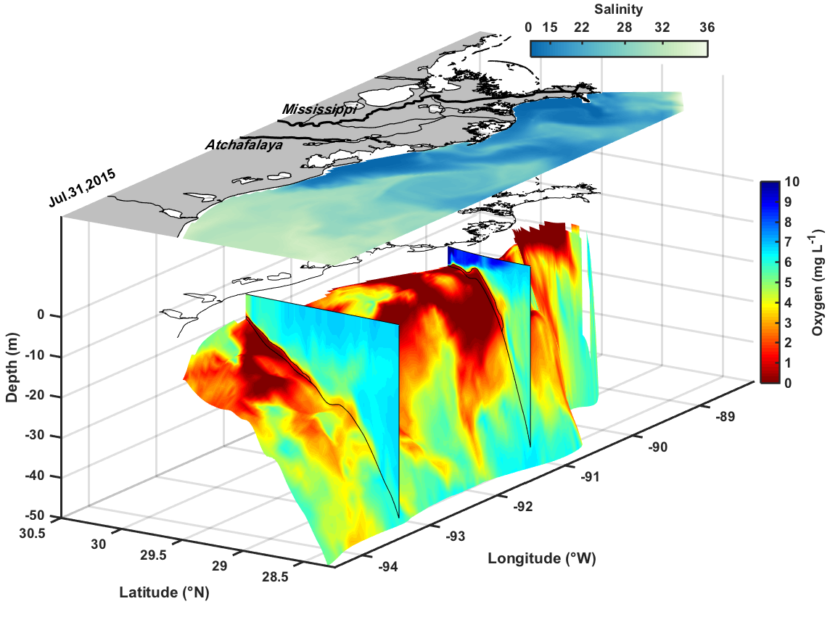
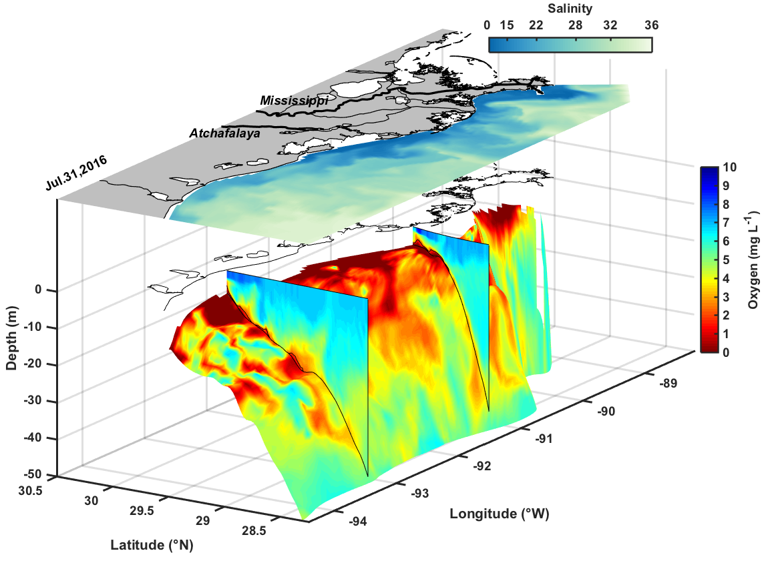
Distribution of hypoxic area in 2015 and 2016 at the time of the hypoxia monitoring cruise (both from ROMS) – 3D view
2015
2016

Slide 7
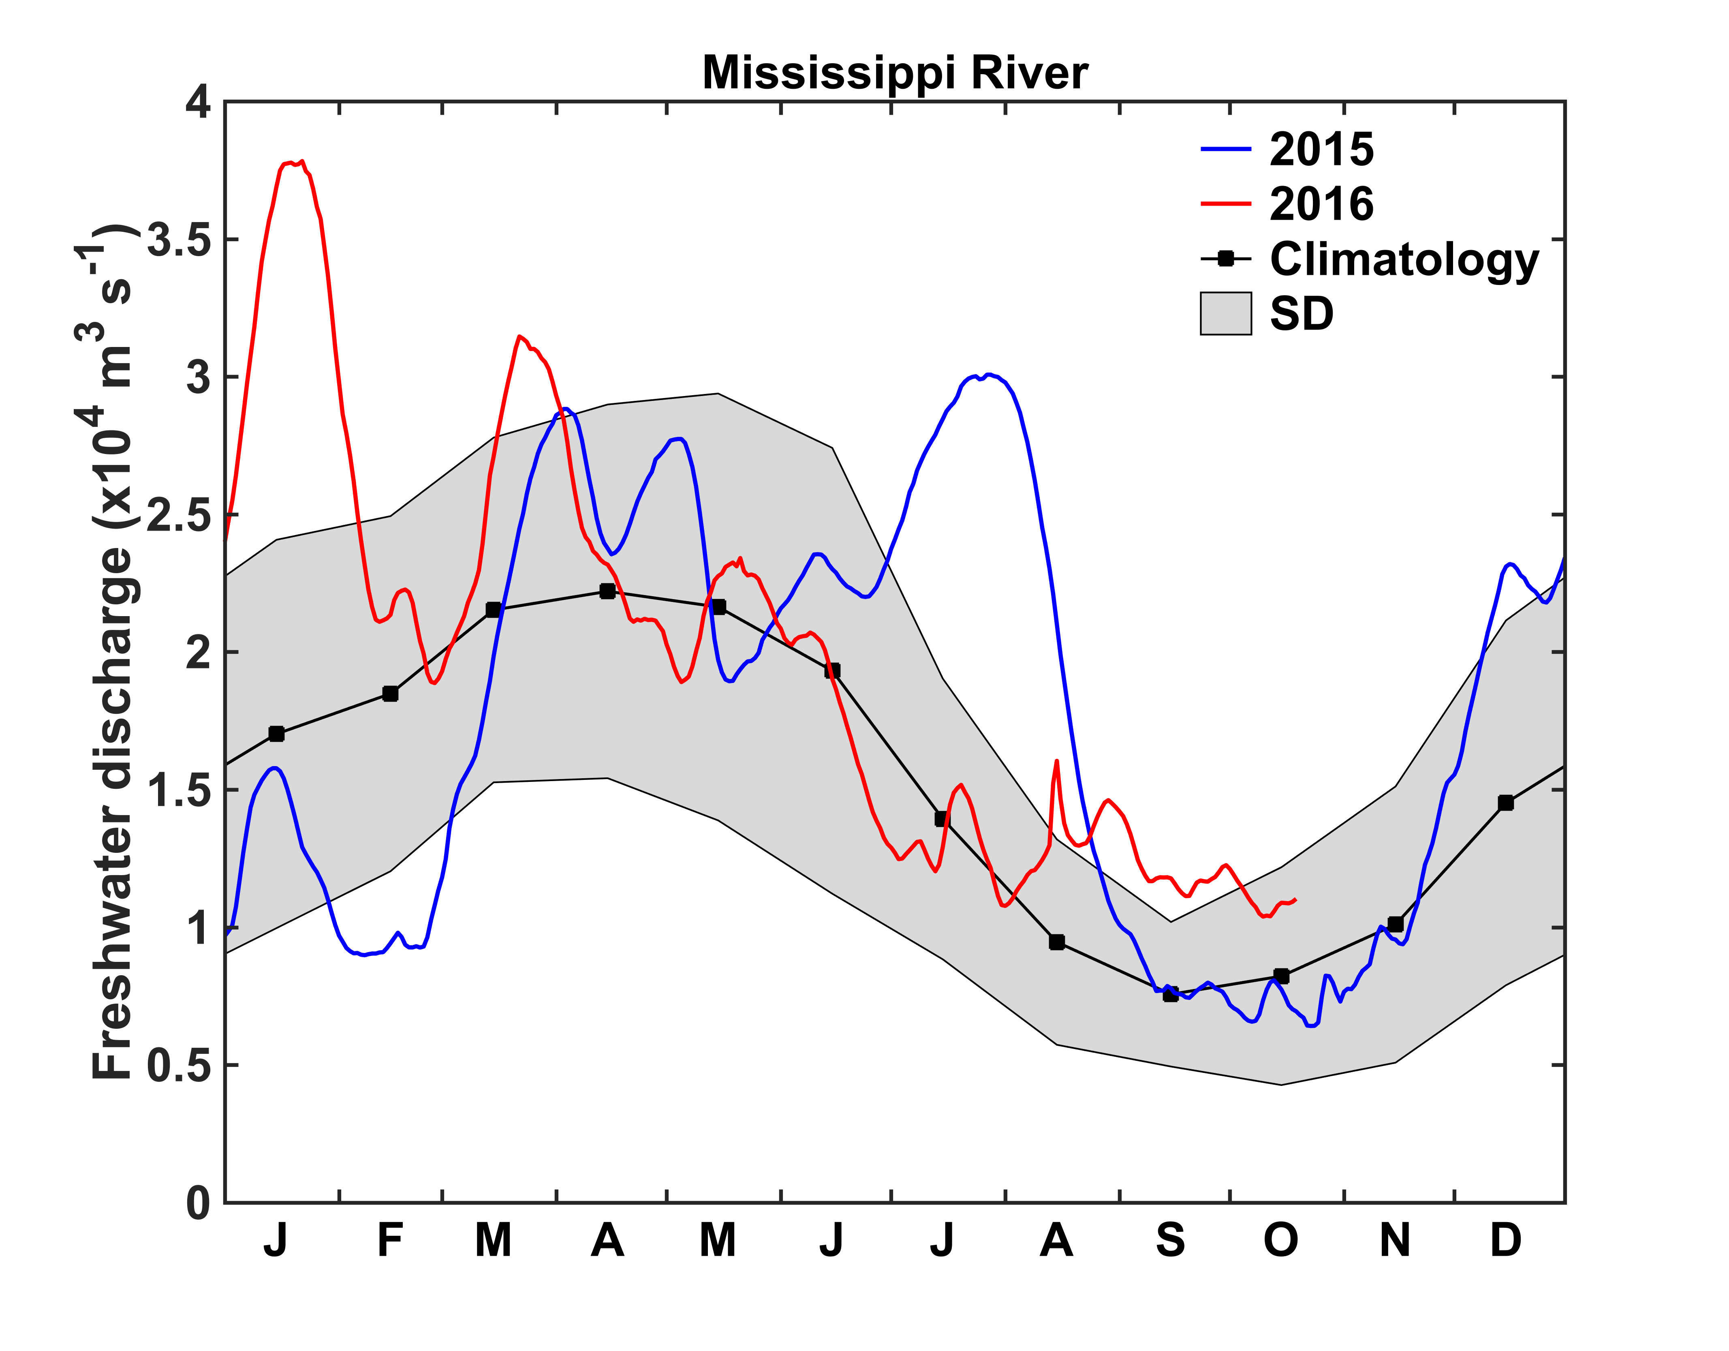
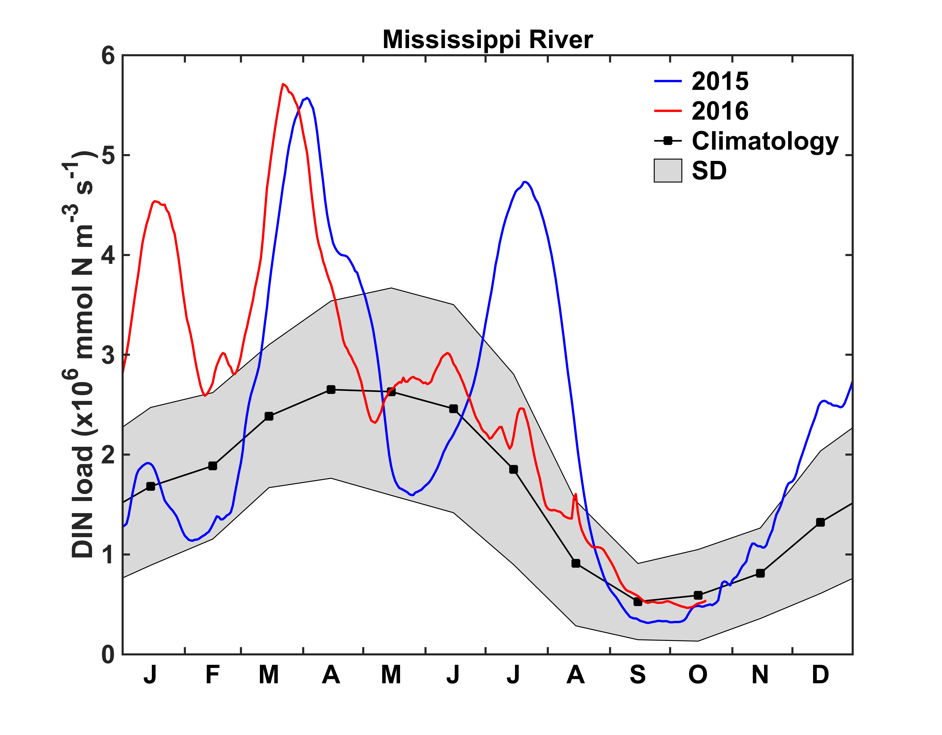
Freshwater and inorganic nitrogen loads for 2015 and 2016
Note the large freshwater discharge and DIN load in summer 2015.
In 2016 both are closer to average in the summer.

Slide 8
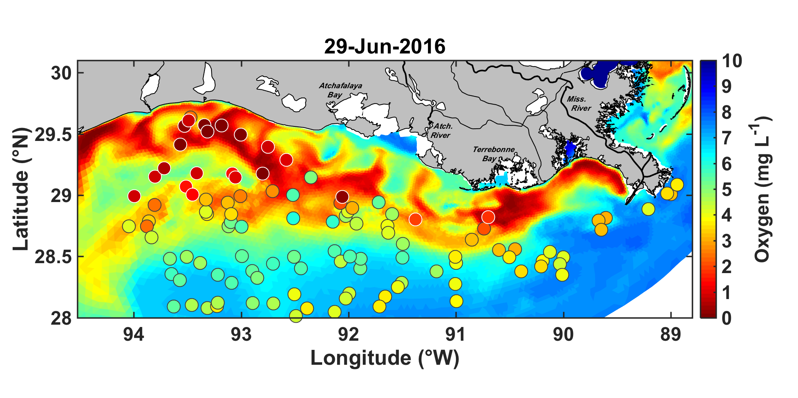
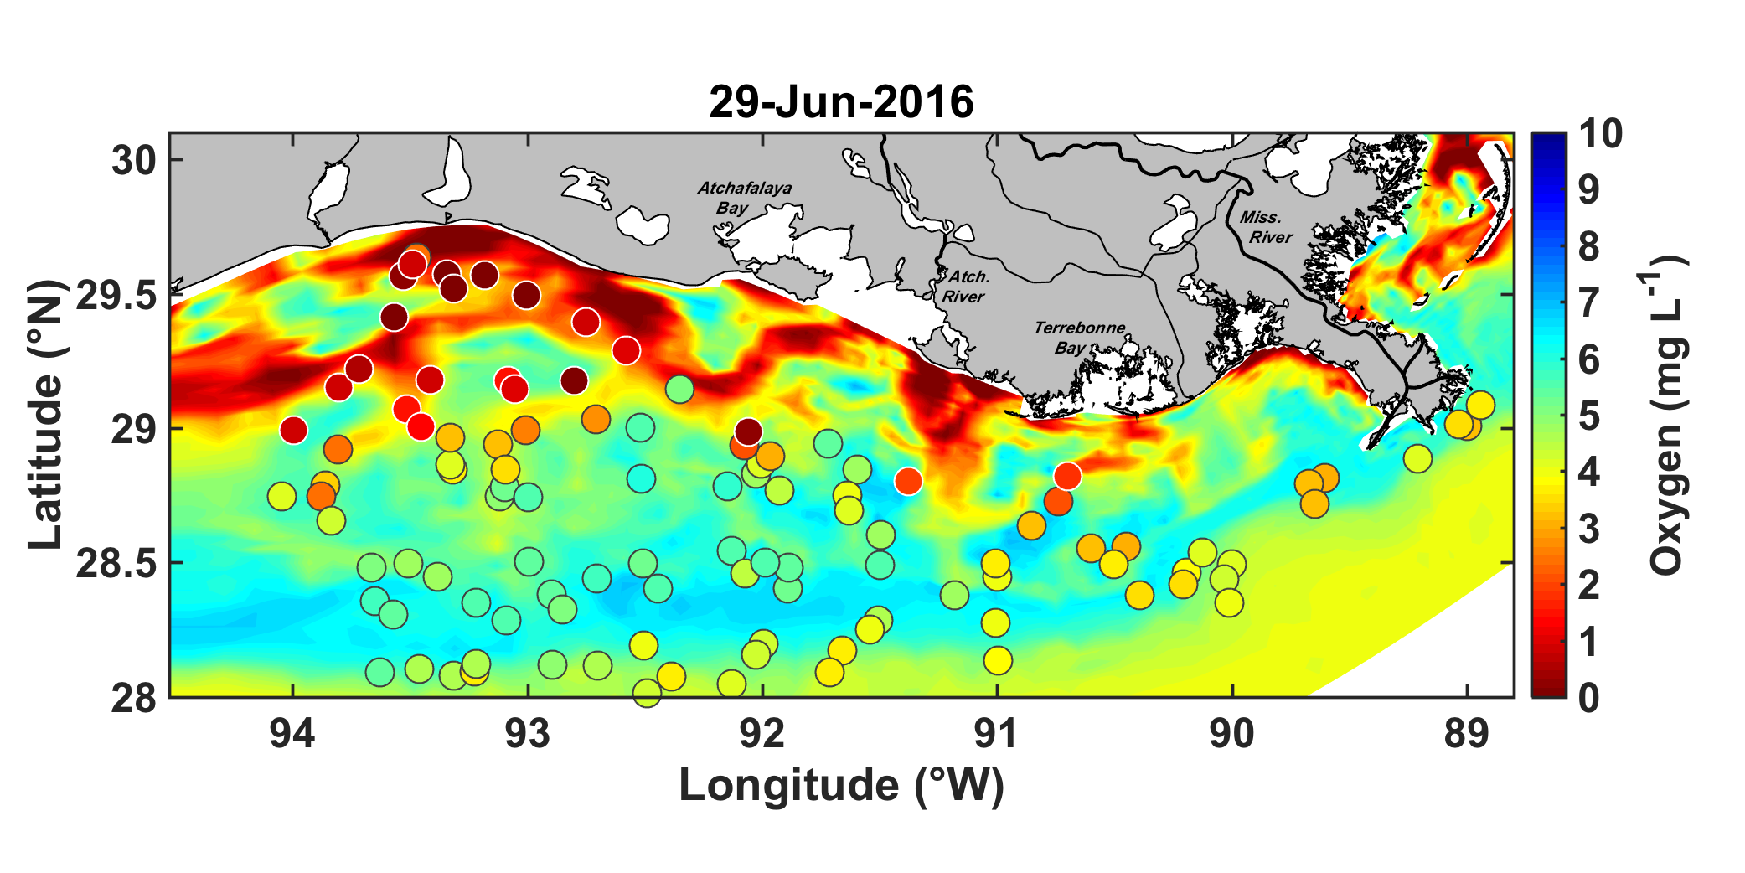
Comparison of simulated bottom DO with SEAMAP observations 2016
FVCOM:
ROMS:
Colored dots represent the observations

Slide 9
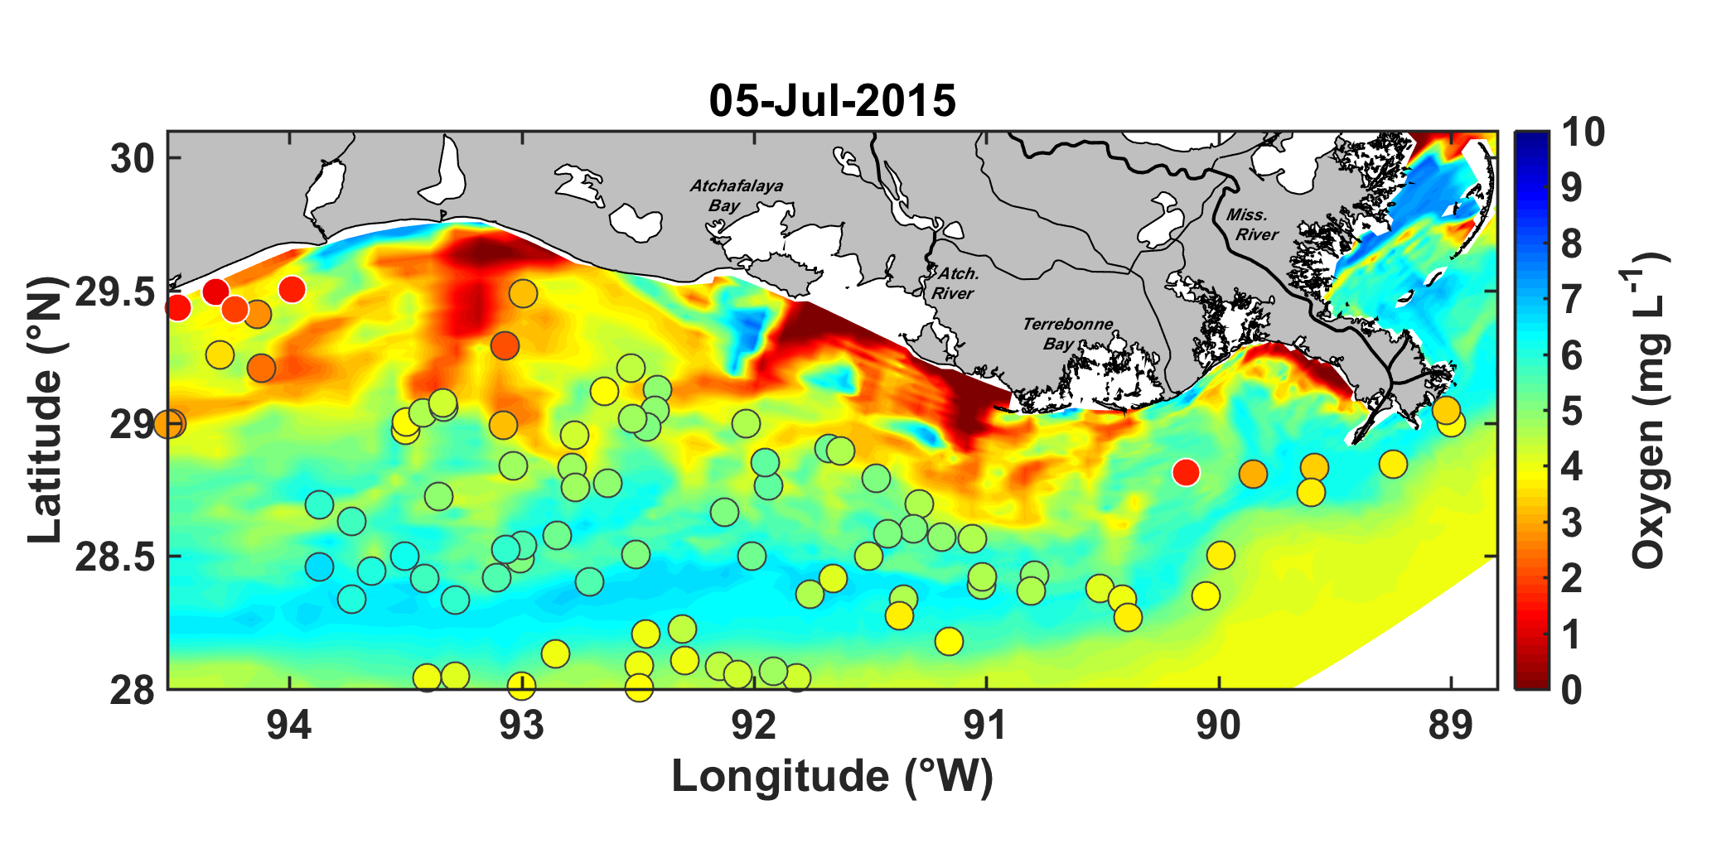
Comparison of simulated bottom DO with SEAMAP observations 2015
Only available from ROMS
Colored dots represent the observations

Slide 10
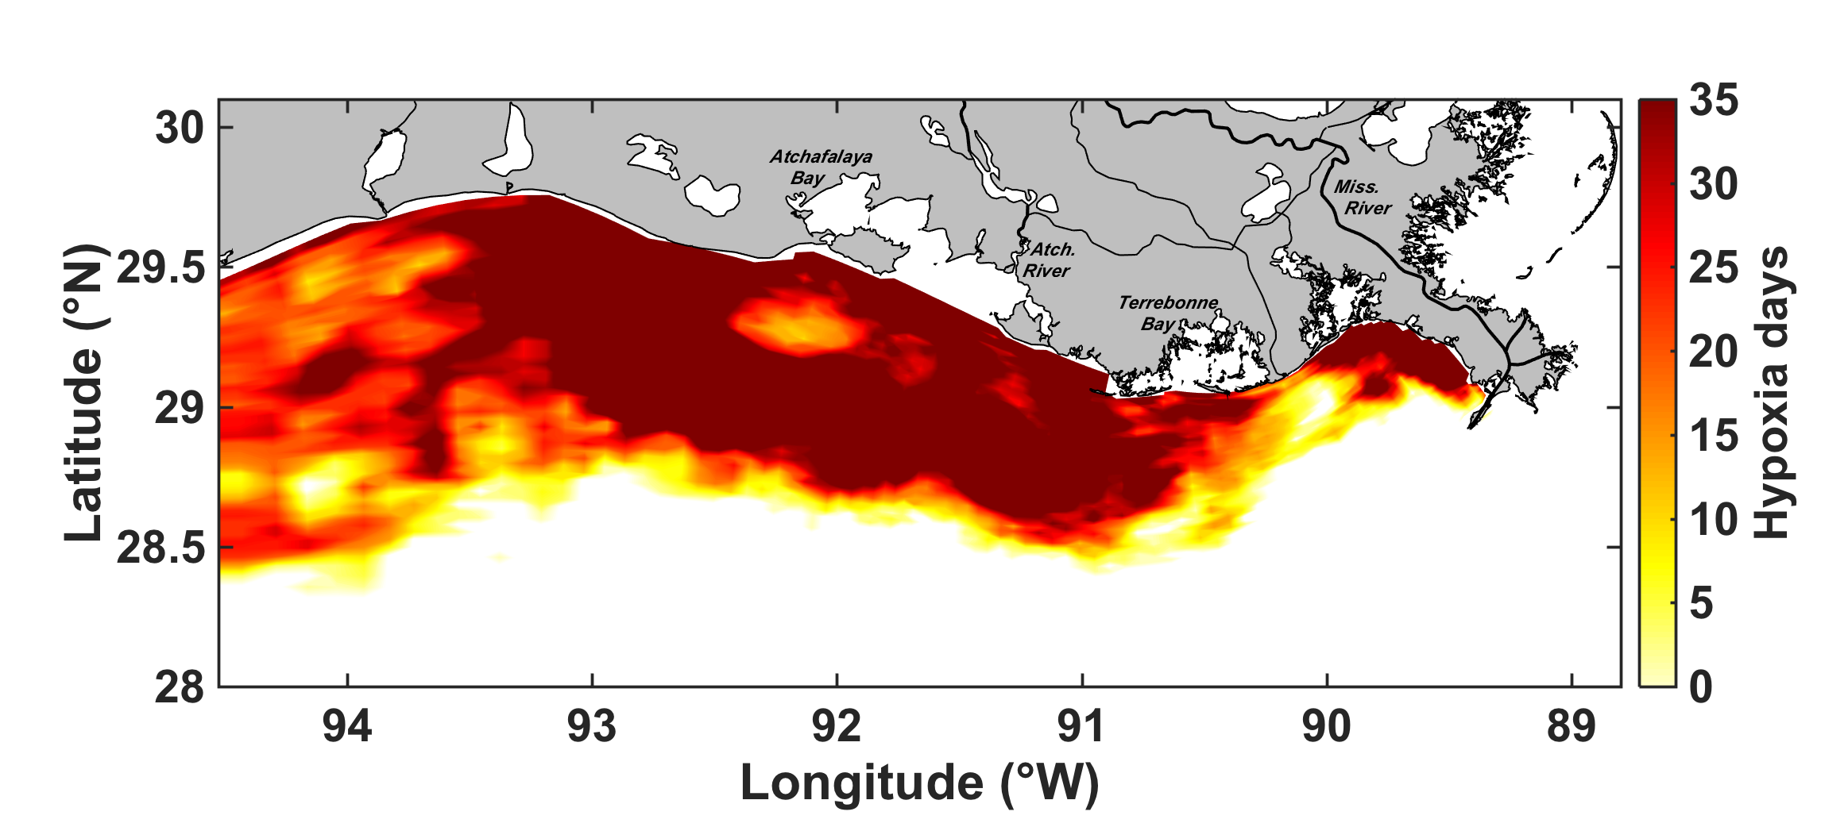
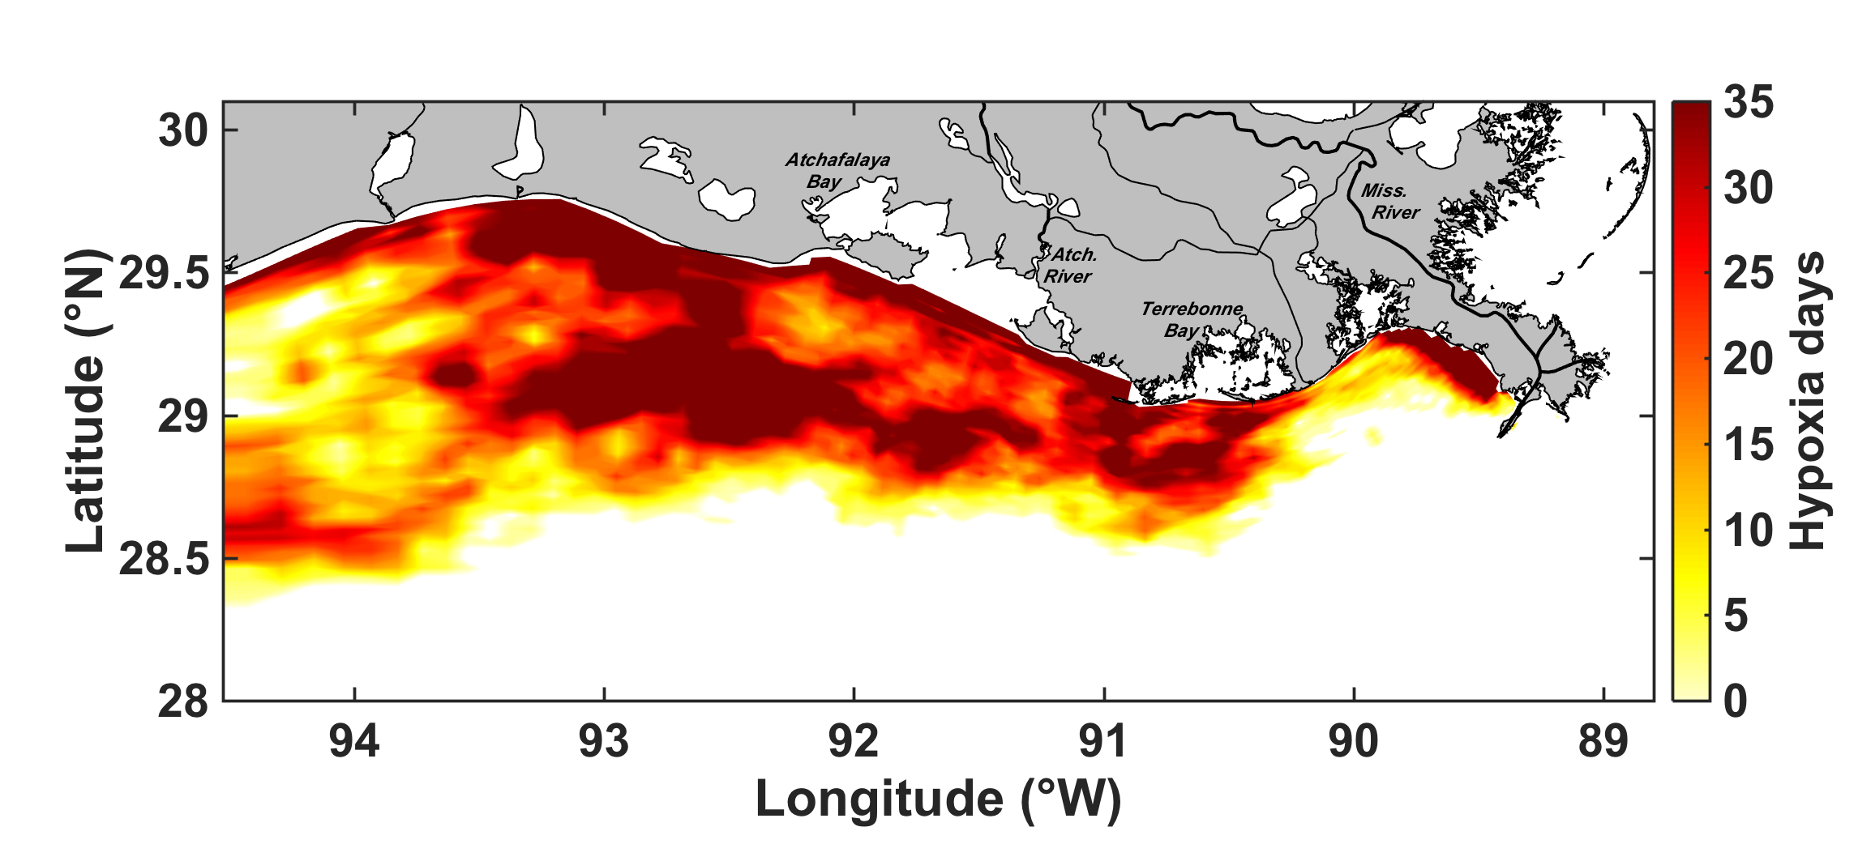
Cumulative exposure to hypoxia (ROMS)
2015
47,500 km²
2016
45,100 km²
(area estimate includes all locations that experienced hypoxia for at least 1 day)

Slide 11
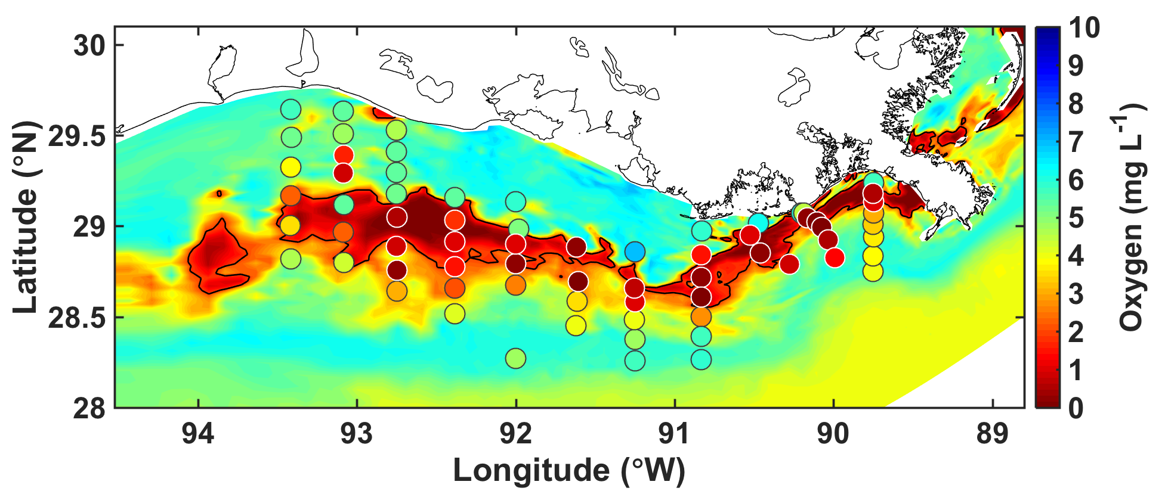
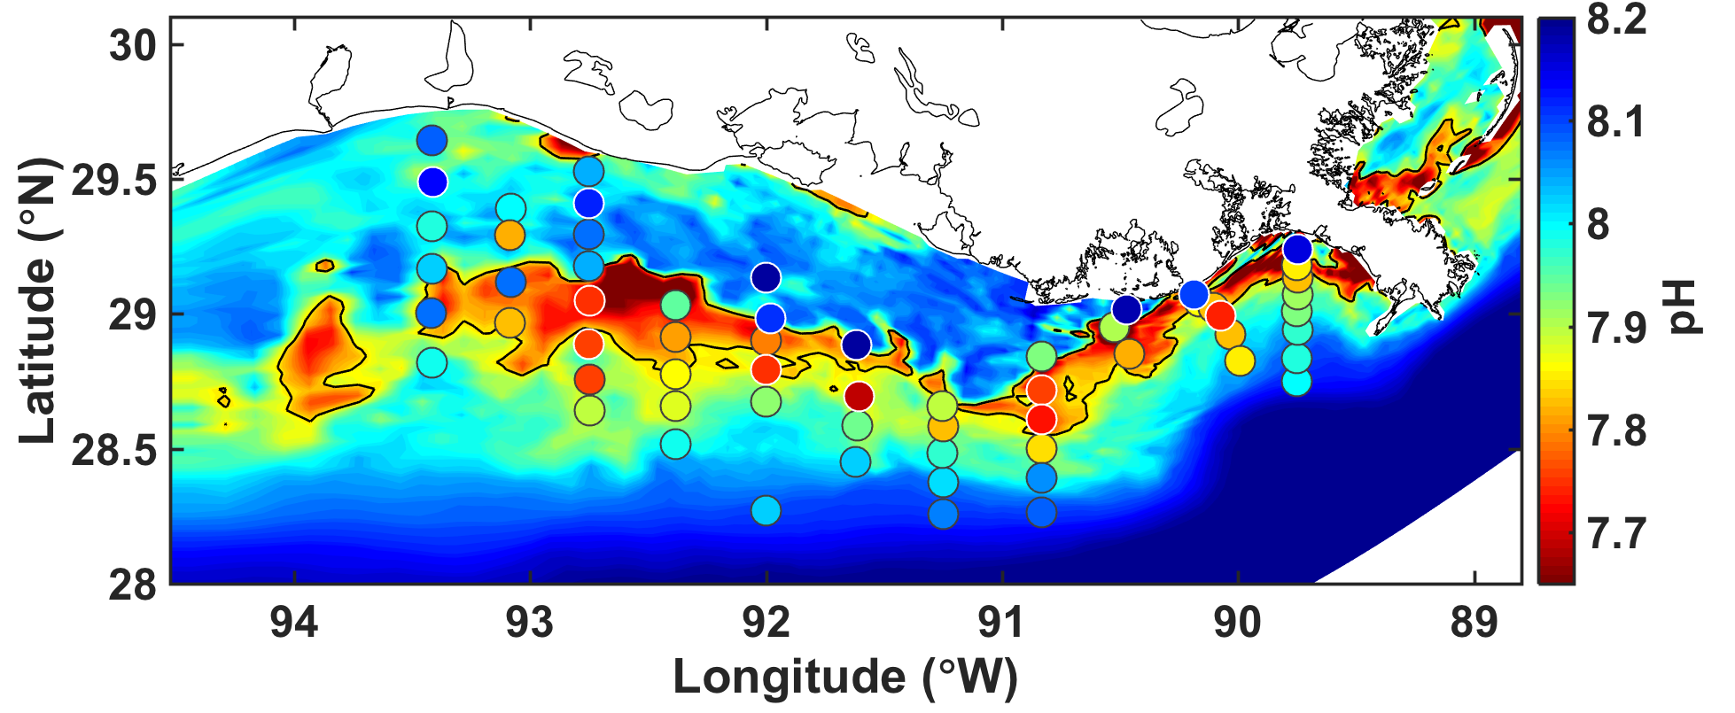
Acidification and hypoxia
The model realistically simulates bottom water hypoxia and eutrophication-driven acidification (low pH)
Hypoxia and low pH are co-located; they are combined stressors affecting the ecosystem
Results for June 2007 from ROMS with Oxygen and inorganic Carbon
Manuscript by Laurent et al. in review by GRL

Slide 12
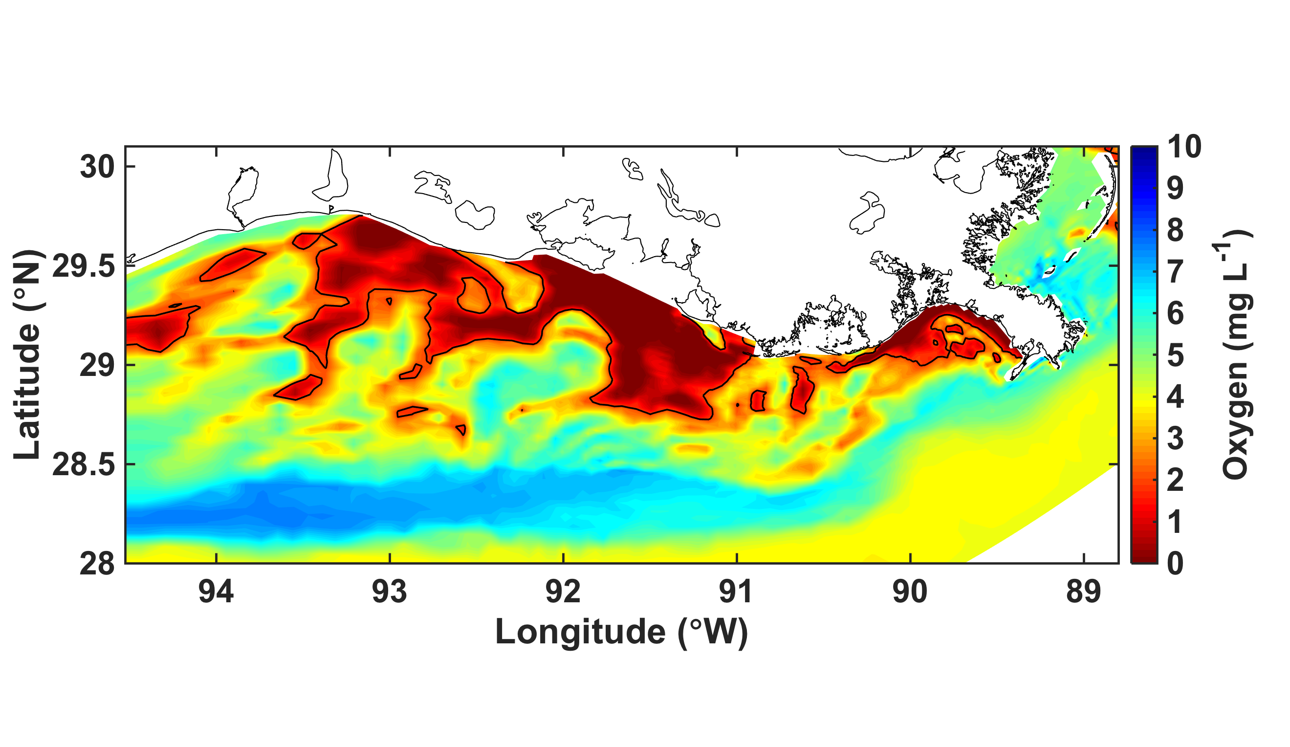
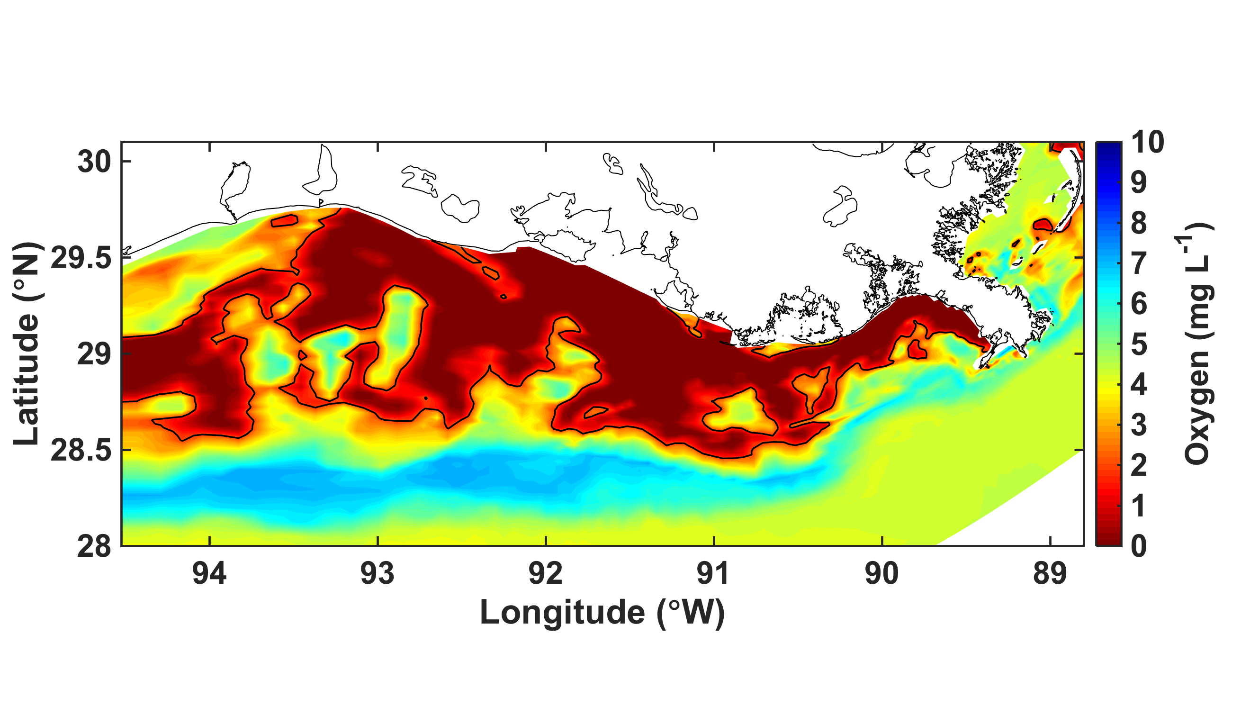
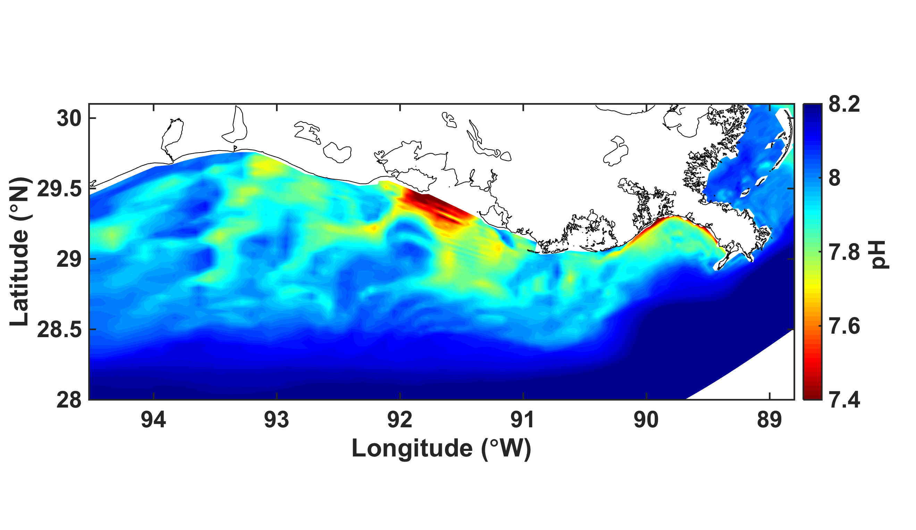
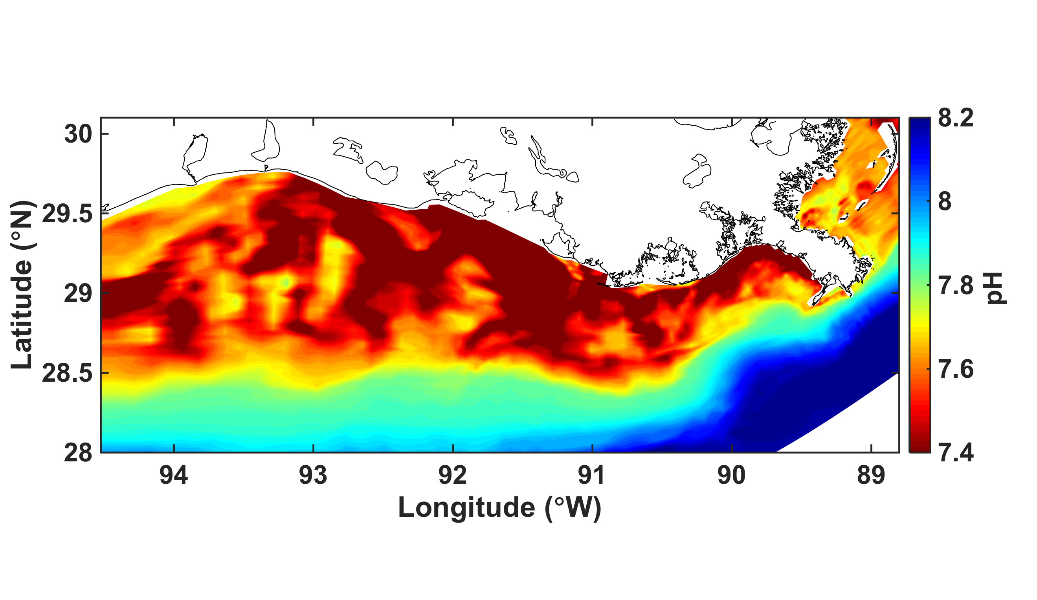
Climate change projection for 2100
Present
Future
Bottom DO
Bottom pH
Future projection show expansion of hypoxic area (primarily due to increased density stratification) and dramatic drop in pH (due to the combination of atmospheric CO₂ levels and enhanced stratification).
Bottom waters are undersaturated with respect to aragonite by 2100.
Manuscript in preparation by Laurent et al.

